Slide 1
Agenda
🏠 Housekeeping
📌 Notes about the website 📌 Review sessions 📌 Final paper ❓ (Clarify expectations)
📖 Learn: Partial and Semi-Partial Correlation
📊 Example: PRAMS dataset on partial and semi-partial correlation 📊 Example: Mechanics of partial and semi-partial correlation (Annotated JASP file) 📊 Example: Graduate GPA for Multiple Linear Regression (MLR) mechanics
📖 Learn: Simple and Multiple Linear Regression (SLR & MLR) in R
📂 Data: Admissions dataset 🧠 Concept: Understanding confidence intervals & intuition about CI accuracy
✏️ Hands-on practice: Running multiple regression NSCAW I Dataset
📖 Learn: Model Assumptions
✅ Checking assumptions for regression models

Slide 2
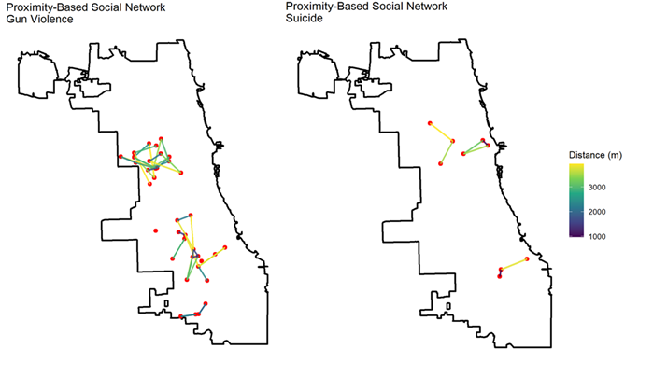
Proximity-Based Social Networks (PBSN)
Data: Gun violence/suicide/Chicago city boundary
The PBSN is built using both spatial and temporal proximity criteria:
Sensitivity – different space-time thresholds used to create the networks
Why do this?
To identify clusters of incidents that are likely socially or environmentally connected
To identify social contagion effects in suicides and homicides
Policy Implications
To inform targeted violence prevention efforts by identifying high-risk social networks.

Slide 3
Introduction to Multiple Linear Regression
What is it and how it works

Slide 4
What is MLR and how does it work?
In MLR, we have two or more predictor (independent, control) variables and one dependent variable
Two or more independent or predictor variables are incorporated via partial and semipartial correlations

Slide 5
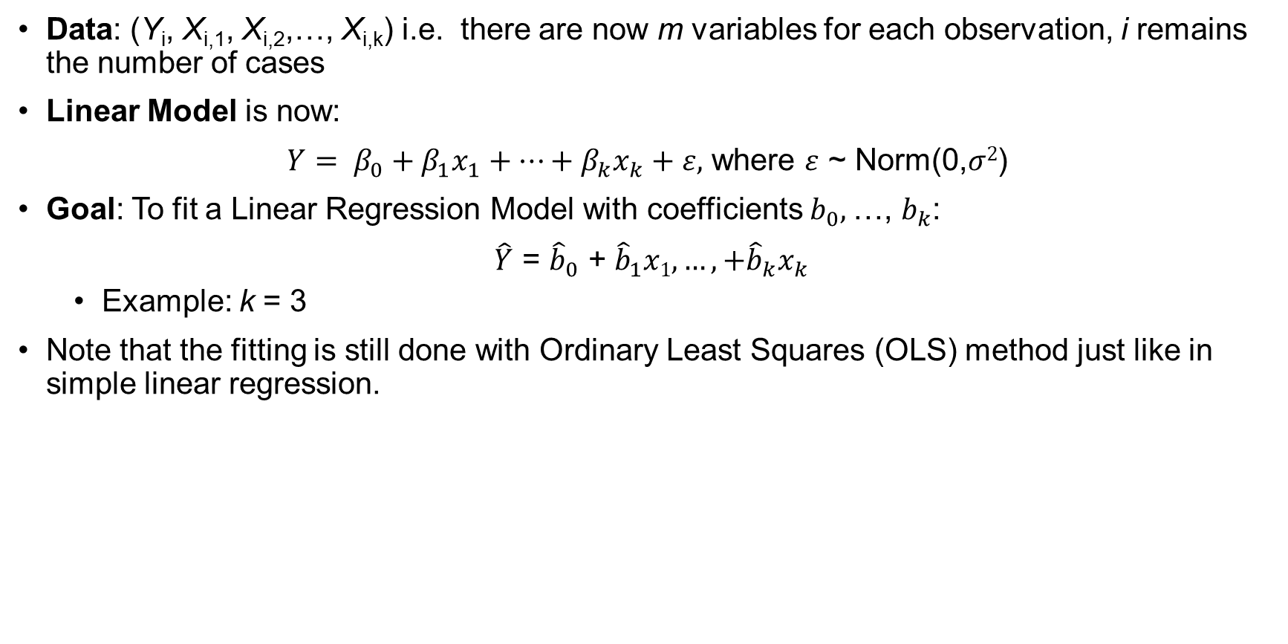
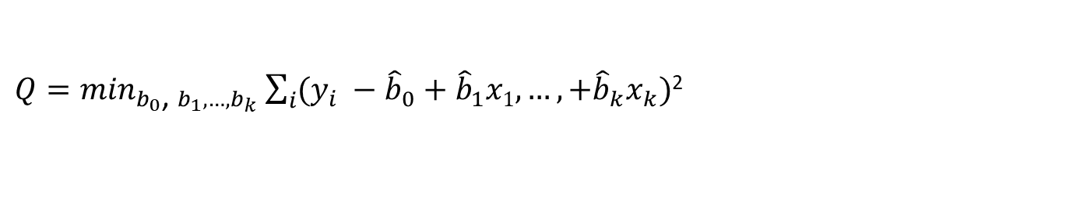
Multiple Linear Regression
Data: (Y_{i}, X_{i,1}, X_{i,2},…, X_{i,k}) i.e. there are now m variables for each observation, i remains the number of cases
Linear Model is now:
$Y= β_{0}+β_{1}x_{1}+…+β_{k}x_{k}+ε,$ where $ε$ ~ Norm(0,$σ2$)
Goal: To fit a Linear Regression Model with coefficients $b_{0},$…, $b_{k}$:
$\hat{Y}$ = ${\hat{b}}_{0}\text{ +} {\hat{b}}_{1}x1, …,+{\hat{b}}_{k}x_{k}$
Example: k = 3
Note that the fitting is still done with Ordinary Least Squares (OLS) method just like in simple linear regression.
${Q=min}_{b_{0}\text{, }b_{1}, …,b_{k}}\sum_{i}{(y_{i} −{\hat{b}}_{0}\text{ +} {\hat{b}}_{1}x1, …,+{\hat{b}}_{k}x_{k})}$²

Slide 6
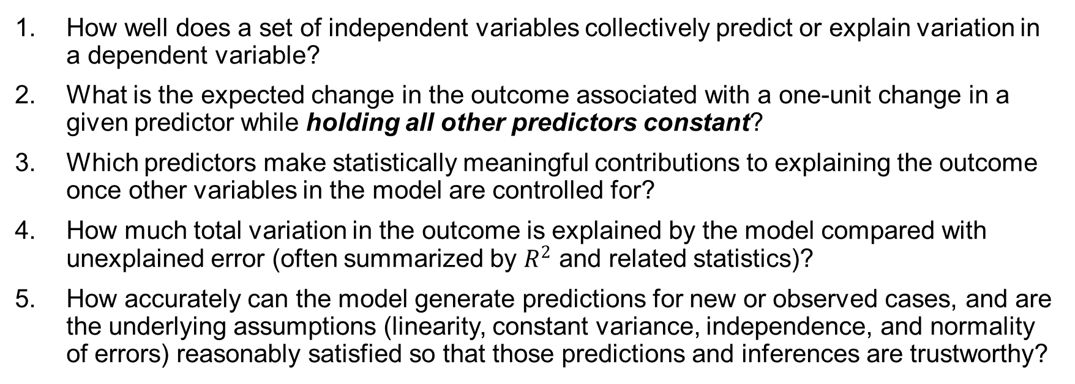
Key Questions
How well does a set of independent variables collectively predict or explain variation in a dependent variable?
What is the expected change in the outcome associated with a one-unit change in a given predictor while holding all other predictors constant?
Which predictors make statistically meaningful contributions to explaining the outcome once other variables in the model are controlled for?
How much total variation in the outcome is explained by the model compared with unexplained error (often summarized by $R^{2}$ and related statistics)?
How accurately can the model generate predictions for new or observed cases, and are the underlying assumptions (linearity, constant variance, independence, and normality of errors) reasonably satisfied so that those predictions and inferences are trustworthy?

Slide 7
Similarities/Differences between MLR and SLR
F-test (ANOVA table): Tells us whether any independent variables are significant
H₀: β_{i} = 0 for all i or H₀: β₁ = β₂ ₌ β_{3 …} β_{k} = 0 (None of the X variables have linear relationships with Y)
H₁: β_{i} ≠ 0 for some i (At least one X variable has a linear relationship with Y)
Note: in SLR, since we have only 1 predictor, the t-test of the slope and the F-test are the same
Intercept (Y-intercept): β₀ is the expected value of Y when all predictors are zero
Slope(s): β_{i} is the expected change in response (Y) for every 1 unit increase in X_{i}, while holding all other predictors constant.
Individual t-tests for each coefficient are reported in the summary
R²: Proportion of variance in Y that is explained by the independent variables
Now, it’s the proportion explained by all independent variables
Use adjusted R² because it adjusts for the number of predictors (same interpretation) as opposed to regular R^{2,} which always increases in # predictors

Slide 8
Correlation: Interpretation & Connection to MLR
In multiple linear regression, you include multiple predictors to isolate the unique contribution of each predictor to the outcome
As a three-variable example:
Partial correlation partial correlation represents the linear relationship between X₁ and Y independent of the linear influence of X₂
Semipartial (part) correlation represents the linear relationship between X₁ and Y after that portion of Y that can be linearly predicted from X₂ has been removed from Y
I am going through several examples today, at home you should go through the examples yourself, making sure you understand.

Slide 9
Correlation: Interpretation & Connection to MLR
Partial correlation (What is the true relationship between X₁ and Y)
Partial correlation examines the relationship between two variables while statistically holding others constant (i.e., controlling for confounders in a regression model)
"What is the relationship between X₁ and Y once the influence of another variable, say X₂ has been removed from both?“
What does it mean ‘to control for’ another variable? Provide an example of how controlling for gender may affect the association between income and education, and why?
Semipartial (How much additional variance in Y does X₁ explain beyond X₂?)
In multiple regression, the semipartial correlation squared (sr²) represents the unique contribution of a predictor (X₁) to the outcome (Y) over and above other predictors.
It answers: “If I add this predictor to the model, how much additional variance in Y does it explain?”
Notes:
For example, suppose we want to understand how education affects income, but we know that income also differs by gender on average. If we do not control for gender, part of the observed relationship between education and income could actually reflect gender differences rather than the true effect of education.
When we control for gender in a regression model, we are essentially comparing people with similar gender status and asking: among people of the same gender, does more education still predict higher income? This allows us to estimate the effect of education on income independent of gender differences.

Slide 10
Partial correlation Intuition
The correlation between two variables (X₁ and Y) after the influence of a third variable (X₂) is removed from both
Example: What is the relationship between study time and exam scores?
You find a positive correlation between them using Pearson’s r.
Another variable, X₂ may be related to both
We want to remove that influence before concluding there is a relationship between X₁ and Y

Slide 11
Partial correlation Example
Definition: The correlation between an independent variable and a dependent variable after controlling for the influence of other variables on both the independent and dependent variables.
Scenario: Regress SAT Math on SAT Verbal and Class Size
The "Unaccounted For" Part:
We remove the effect of Class Size from SAT Math.
We remove the effect of Class Size from SAT Verbal.
We look at the correlation between what is left over (the residuals of both).
Intuition: "If everyone had the exact same class size, how strongly would their Verbal scores predict their Math scores?"

Slide 12
Partial correlation: Running Example
A partial correlation between education and income controls for gender in both variables.
Remove gender effects from income → get residual income.
Remove gender effects from education → get residual education.
Correlate the two residuals.
So we examine:
income independent of gender
education independent of gender and then correlate them.
This tells us the relationship between education and income net of gender for both variables.

Slide 13
Semipartial correlation Intuition
Definition: The correlation between an independent variable and a dependent variable after controlling for the influence of other variables only on the independent variable.
Scenario: Regress SAT Math on SAT Verbal, removing the influence of Class Size from SAT Verbal only.
The "Unaccounted For" Part:
We remove the effect of Class Size from SAT Verbal to get the "Pure Verbal" score.
We rely on the original, ‘messy’ SAT Math score.
We correlate "Pure Verbal" with the original SAT Math.
Intuition: "How much of the total variation in Math scores can be explained uniquely by the part of Verbal scores that isn't related to Class Size?"
Why use this? This is useful if you want to see how much unique variance (R-squared change) SAT Verbal adds to the model, over and above Class Size.

Slide 14
Semipartial (part) correlation
A semipartial correlation removes gender from only one variable—usually the predictor.
Remove gender effects from education.
Correlate that adjusted education with raw income.
This shows how much unique variance education contributes to income beyond gender.

Slide 15
Summary
The key difference between partial and semipartial correlation is in how they adjust for the third variable (X₂) and what they tell us about prediction
Type | What It Controls For | Meaning in terms of Y, X₁, and X₂ | Regression Interpretation
Partial correlation | Removes the effect of X₂ from both Y and X₁ | Examines the relationship between Y and X₁ after both have had the influence of X₂ removed, so the association reflects only the variation in Y and X₁ unrelated to X₂. | Closely related to the standardized regression coefficient (β) for X₁ in a model predicting Y from X₁ and X₂.
Semipartial (part) correlation | Removes the effect of X₂ from only X₁ | Examines how much unique variation in Y is associated with the part of X₁ that is independent of X₂, while Y remains unchanged. | The square of this correlation equals the unique R² contribution of X₁ when added to a model already containing X₂.
https://issues-osu.github.io/statsii-spring2026/slides/MLR/correlate.R

Slide 16
What is confounding?
A related challenge arises when an important variable is omitted from the model. Confounding occurs when a third variable influences both a predictor and an outcome, distorting the apparent relationship between them.
If an omitted variable affects both the predictor and the outcome, the estimated effect of the predictor becomes biased.
This problem is often referred to as omitted variable bias and is one of the main ways confounding enters regression models

Slide 17
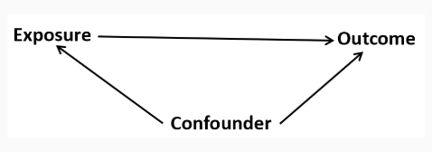
What is confounding?
To be a confounding factor, three conditions must be met:
The confounding variable must be associated with the exposure (but not a consequence of the exposure)
The confounding variable must be associated with the outcome independently of exposure
The confounding variable cannot be an intermediary step in the causal pathway from the exposure of interest to the outcome of interest.

Slide 18
What is confounding important?
By controlling for confounding, we can obtain an unbiased estimate of the ‘causal’ relationship between exposure and outcome
Two ways to deal with confounding
The study design phase (by randomization, restriction, and matching)
During data analysis (by stratification, propensity score matching, and multivariate analysis - MRL)

Slide 19
The next four slides are from our paper titled , “Redlining, Reinvestment, and Racial Segregation: A Bayesian Spatial Analysis of Mortgage Lending Trajectories and Firearm-Related Violence” forthcoming in Injury Epidemiology
Example

Slide 20
Example
Study Objective: Examining the relationship between lending trajectory (historical and contemporary housing discrimination) and firearm-related homicide victimization
Key Variables: Lending Trajectory (Main Exposure): Sustained Disinvestment, Disinvestment, Growing Investment, High Investment
Firearm-Related Homicide (Outcome)
Possible confounders
Area Deprivation Index (ADI): Measure of socioeconomic disadvantage
Racial Segregation: Degree of racial isolation within neighborhoods
Argue that ADI and racial segregation are potential confounders
Argue that ADI and racial segregation are NOT potential confounders

Slide 21
Conceptual Issues in Adjusting for ADI and Racial Segregation
Omitting ADI and Racial Segregation:
The key question is whether we should include the Area Deprivation Index (ADI) and racial segregation in the model or leave them out when studying how lending patterns relate to firearm homicide.
If we leave ADI and segregation out, we risk confounding.
The model risks omitted variable bias, leading to an overestimated or misattributed effect of lending trajectory on firearm-related homicide.
In other words, we could overstate or misinterpret the effect of lending because we are ignoring other structural conditions that also influence violence
Including ADI and Racial Segregation as Covariates:
For: If ADI and segregation are confounders, their inclusion helps isolate the true effect of lending trajectory
Against: risks over-adjustment if these variables are actually part of the causal pathway (i.e., mediators).

Slide 22
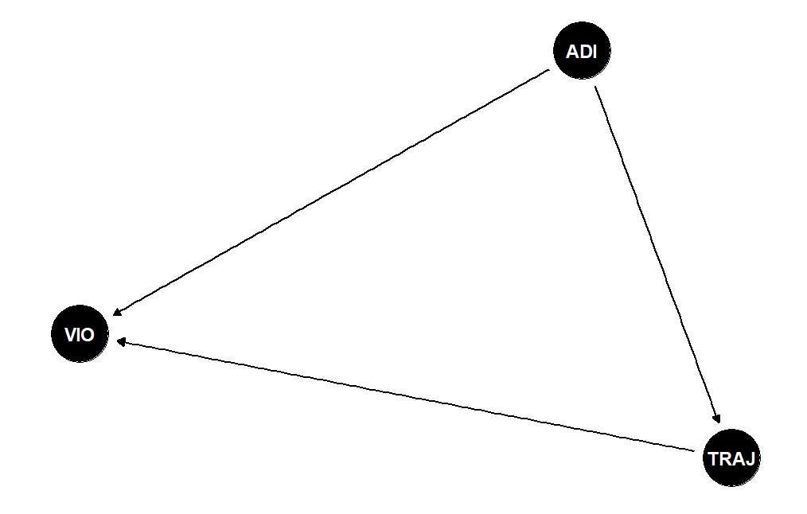
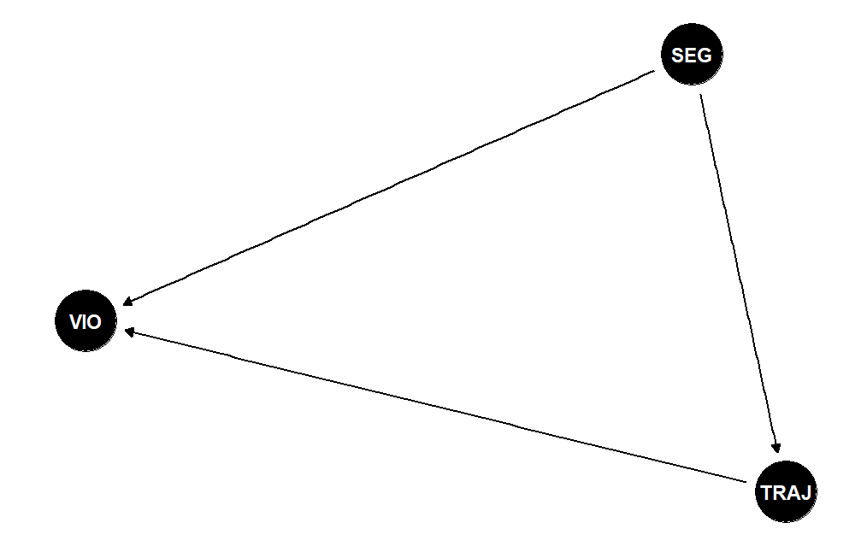
Simple confounding
dag_ex.R

Slide 23
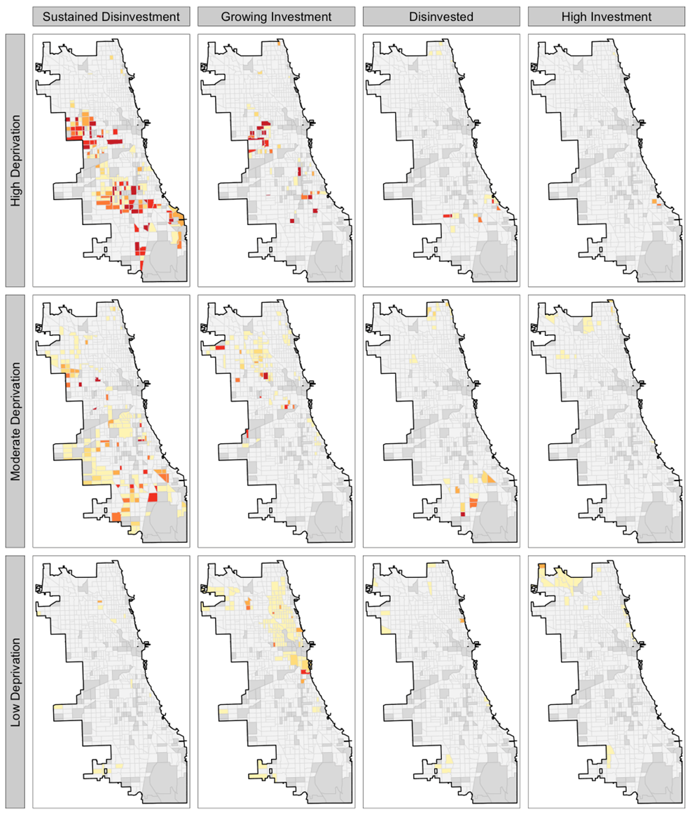
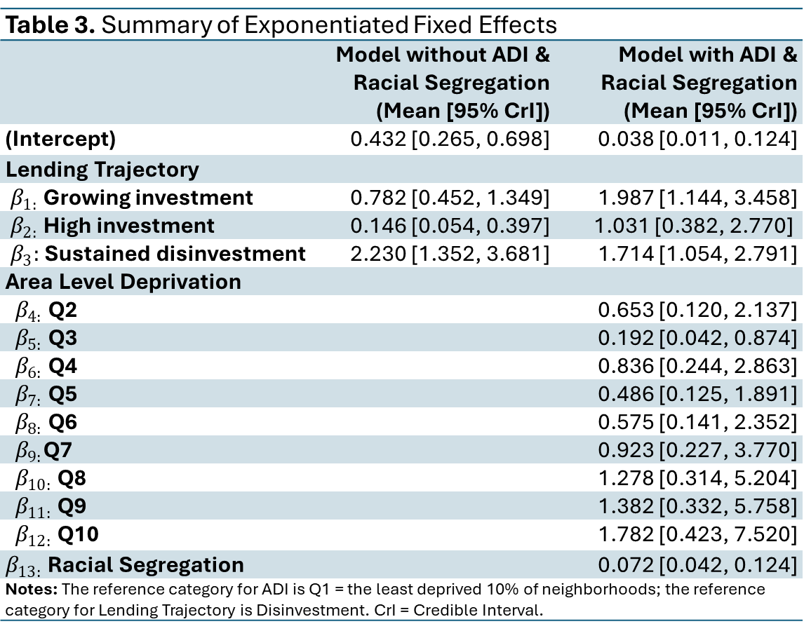
Note to self: stop to explain this
Table 3. Summary of Exponentiated Fixed Effects
 | Model without ADI & Racial Segregation (Mean [95% CrI]) | Model with ADI & Racial Segregation (Mean [95% CrI])
(Intercept) | 0.432 [0.265, 0.698] | 0.038 [0.011, 0.124]
Lending Trajectory
$β_{1:}$ Growing investment | 0.782 [0.452, 1.349] | 1.987 [1.144, 3.458]
$β_{2:}$High investment | 0.146 [0.054, 0.397] | 1.031 [0.382, 2.770]
$β_{3}:$Sustained disinvestment | 2.230 [1.352, 3.681] | 1.714 [1.054, 2.791]
Area Level Deprivation
$β_{4:}$Q2 |  | 0.653 [0.120, 2.137]
$β_{5:}$Q3 |  | 0.192 [0.042, 0.874]
$β_{6:}$Q4 |  | 0.836 [0.244, 2.863]
$β_{7:}$Q5 |  | 0.486 [0.125, 1.891]
$β_{8:}$Q6 |  | 0.575 [0.141, 2.352]
$β_{9:}$Q7 |  | 0.923 [0.227, 3.770]
$β_{10:}$Q8 |  | 1.278 [0.314, 5.204]
$β_{11:}$Q9 |  | 1.382 [0.332, 5.758]
$β_{12:}$Q10 |  | 1.782 [0.423, 7.520]
$β_{13:}$Racial Segregation |  | 0.072 [0.042, 0.124]
Notes: The reference category for ADI is Q1 = the least deprived 10% of neighborhoods; the reference category for Lending Trajectory is Disinvestment. CrI = Credible Interval.

Slide 24
A more basic analogy
We know that smoking causes cancer by destroying lung cells, so: Smoking → lung damage → cancer.
THIS IS NOT THE LINEAR REGRESSION MODEL!
If we instead model the association between smoking and lung cancer, controlling for lung damage, we are asking: Among people with the same lung damage, does smoking still predict cancer?
But lung damage is exactly how smoking causes cancer. So controlling for it hides part of smoking’s effect.
The reason is: lung damage is part of the process or mechanism through which smoking leads to cancer.
Same logic as our study
Lending practices → neighborhood deprivation/segregation → violence.
If deprivation and segregation are part of how lending produces violence, controlling for them removes part of lending’s effect.

Slide 25
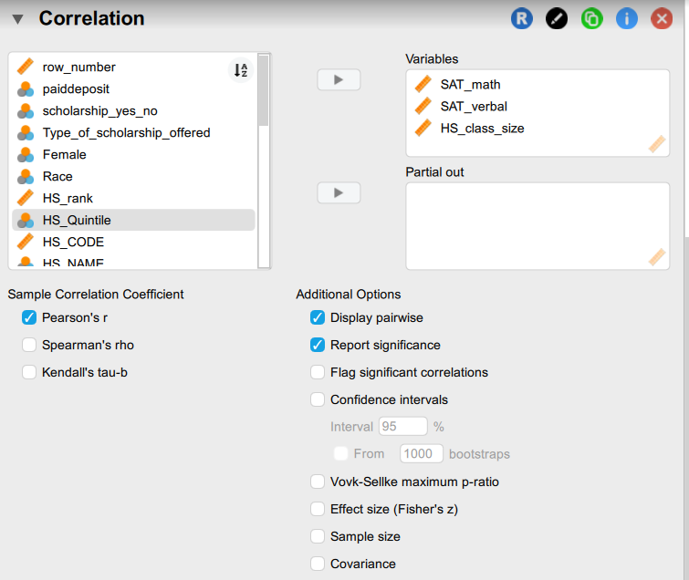
Example: Zero order, part and partial correlation using the admissions data set
Pearson's Correlations
 |  |  | Pearson's r | p
SAT_math | - | SAT_verbal | 0.464 | < .001
SAT_math | - | HS_class_size | 0.176 | < .001
SAT_verbal | - | HS_class_size | 0.045 | .240

Slide 26
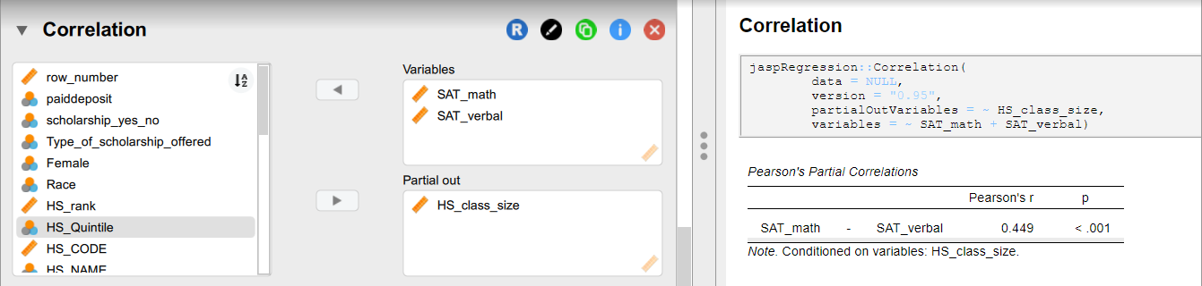
Example: Partial correlation using the admissions data set
Partial Correlation (Second Section: Controlling for HS Class Size)
Analysis: The partial correlation shows the correlation between SAT Math and SAT Verbal while controlling for HS Class Size, which is r = .449, p < .001 (.464 → .449).
Interpretation: Controlling for class size has little effect on the relationship between SAT Math and SAT Verbal, meaning class size does not confound or significantly influence their correlation.

Slide 27
Partial and Semi-Partial Correlation Analysis with PRAMS 8 Data – Statistics for Social Work

Slide 28
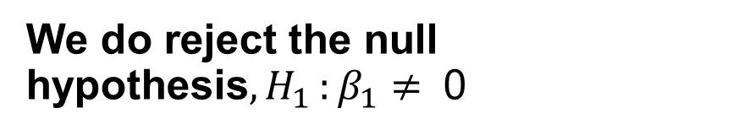
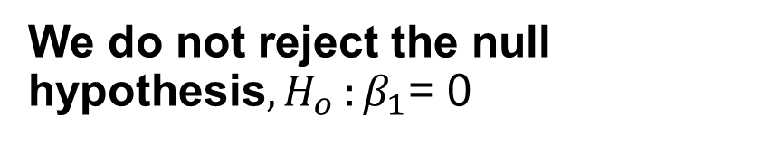
Recall: Inference, Error and Associations
We do not reject the null hypothesis${, H}_{o}:β_{1}$= 0
We do reject the null hypothesis${, H}_{1}:β_{1}≠ \text{0}$
We committed a Type II error
There really is not much of a linear relationship between x and y
There is a relationship between x and y — it is just not linear
We committed a Type I error.
The relationship between x and y is indeed linear.
A linear function fits the data, okay, but a curved ("curvilinear") function would fit the data even better.

Slide 29
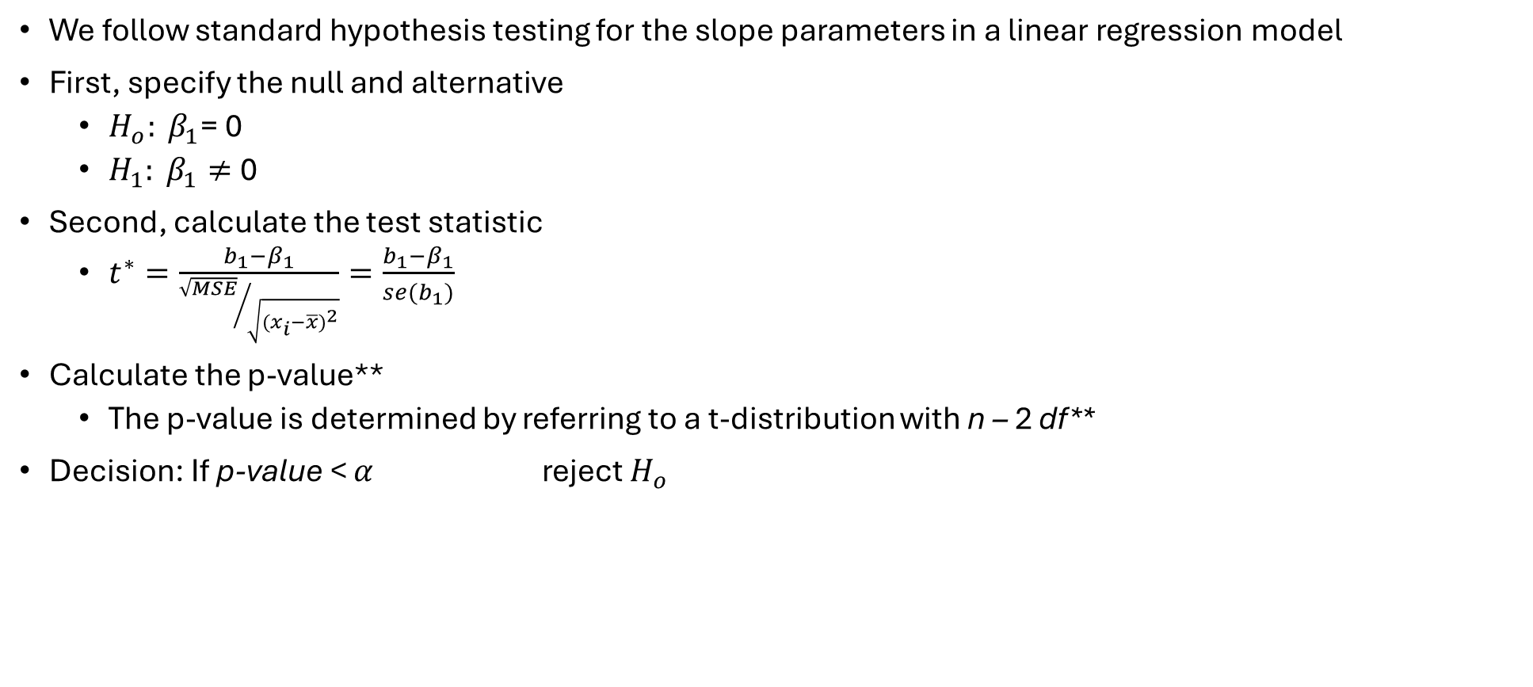
Hypothesis testing of coefficients
We follow standard hypothesis testing for the slope parameters in a linear regression model
First, specify the null and alternative
$H_{o}: β_{1}$= 0
$H_{1}: β_{1}≠$0
Second, calculate the test statistic
$t^{∗}=\frac{b_{1}−β_{1}}{{\sqrt{MSE}}/{\sqrt{{(x_{i}−\overline{x})}^{2}}}}=\frac{b_{1}−β_{1}}{se(b_{1})}$
Calculate the p-value**
The p-value is determined by referring to a t-distribution with n – 2 df**
Decision: If p-value < $α$ reject $H_{o}$

Slide 30
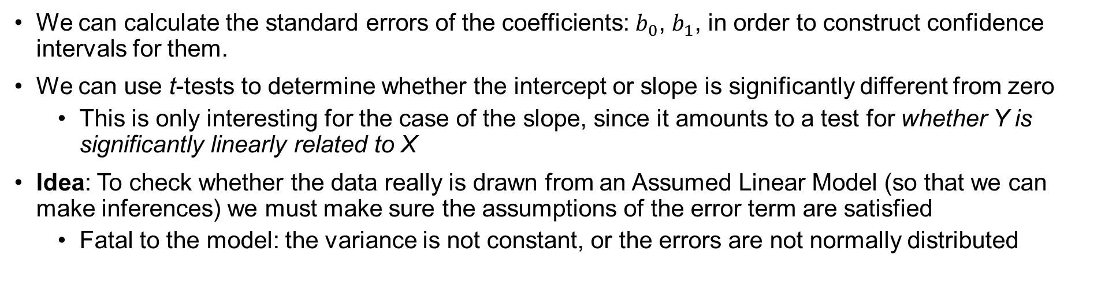
Sampling Distributions & Inference
We can calculate the standard errors of the coefficients: $b_{0}$, $b_{1}$, in order to construct confidence intervals for them.
We can use t-tests to determine whether the intercept or slope is significantly different from zero
This is only interesting for the case of the slope, since it amounts to a test for whether Y is significantly linearly related to X
Idea: To check whether the data really is drawn from an Assumed Linear Model (so that we can make inferences) we must make sure the assumptions of the error term are satisfied
Fatal to the model: the variance is not constant, or the errors are not normally distributed

Slide 31
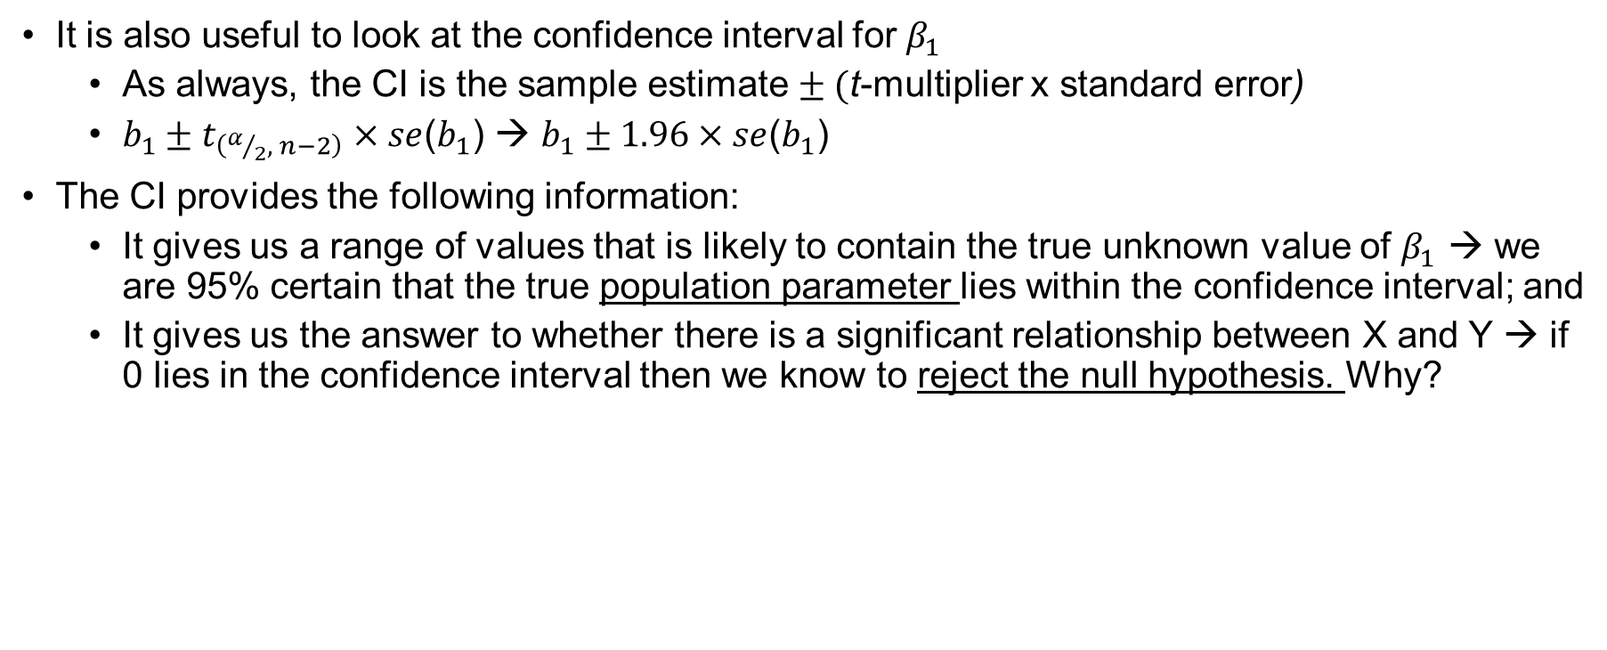
Confidence intervals as hypothesis testing
It is also useful to look at the confidence interval for $β_{1}$
As always, the CI is the sample estimate $± ($t-multiplier x standard error)
$b_{1}±t_{\left(α/2, n−2\right)}×se$($b_{1}$) → $b_{1}±1.96×se$($b_{1}$)
The CI provides the following information:
It gives us a range of values that is likely to contain the true unknown value of $β_{1}$ → we are 95% certain that the true population parameter lies within the confidence interval; and
It gives us the answer to whether there is a significant relationship between X and Y → if 0 lies in the confidence interval then we know to reject the null hypothesis. Why?

Slide 32
Example: Regression with two independent/explanatory variables
Question: How is math SAT score related to verbal SAT score and class size?
“Regress math SAT score on verbal SAT score and class size” What is your intuition about the nature of the relationships in this model and why?
Intuition: higher verbal scores should mean higher math scores because students who work hard at math probably work hard at other courses
Intuition: bigger class size means lower math SAT scores because students have less opportunity to interact with teachers, etc.
Intuition: Also though, verbal SAT scores should mean larger classes as well, for the same reason.
Let’s fit a linear model using the admissions dataset to find out the relationships (if any!).

Slide 33
ANOVA
Model |  | Sum of Squares | df | Mean Square | F | p
M₁ | Regression | 738352.691 | 2 | 369176.346 | 100.802 | < .001
 | Residual | 2.520e+6 | 688 | 3662.387
 | Total | 3.258e+6 | 690
Note. M₁ includes SAT_verbal, HS_class_size
Note. The intercept model is omitted, as no meaningful information can be shown.
Coefficients
 |  |  |  |  |  |  | 95% CI
Model |  | Unstandardized | Standard Error | Standardized | t | p | Lower | Upper
M₀ | (Intercept) | 585.007 | 2.614 |  | 223.792 | < .001 | 579.875 | 590.140
M₁ | (Intercept) | 314.147 | 19.477 |  | 16.129 | < .001 | 275.904 | 352.389
 | SAT_verbal | 0.449 | 0.034 | 0.443 | 13.192 | < .001 | 0.382 | 0.515
 | HS_class_size | 0.060 | 0.013 | 0.156 | 4.656 | < .001 | 0.035 | 0.086

Slide 34
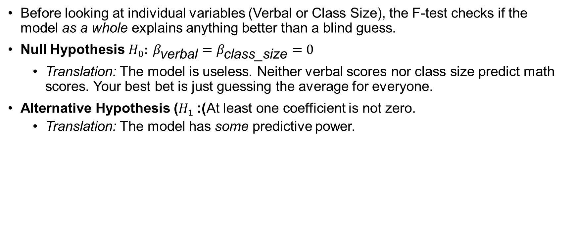
The F-statistic: The overall hypothesis
Before looking at individual variables (Verbal or Class Size), the F-test checks if the model as a whole explains anything better than a blind guess.
Null Hypothesis $H_{0}: β_{\text{verbal}}=β_{\text{class}\text{_}\text{size}}=0$
Translation: The model is useless. Neither verbal scores nor class size predict math scores. Your best bet is just guessing the average for everyone.
Alternative Hypothesis ($H_{1}$): At least one coefficient is not zero.
Translation: The model has some predictive power.

Slide 35
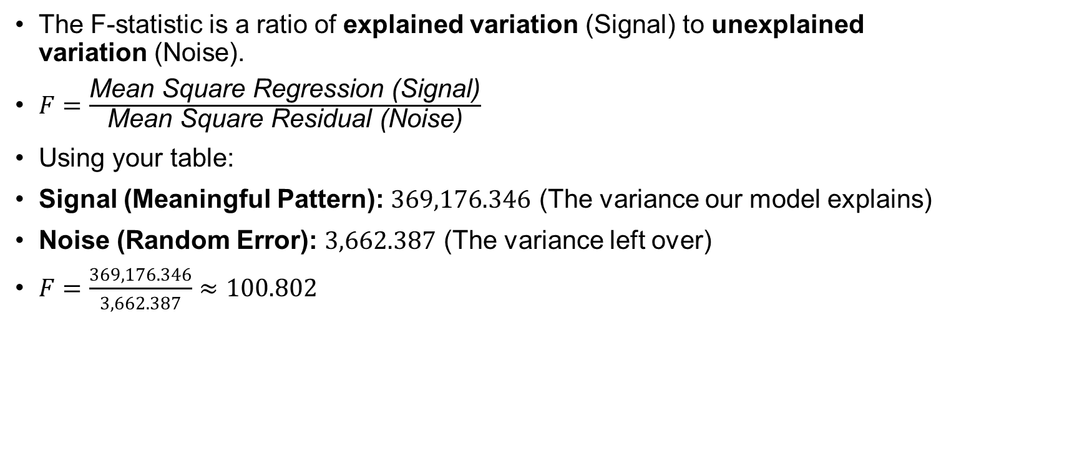
The Ratio: Signal vs. Noise
The F-statistic is a ratio of explained variation (Signal) to unexplained variation (Noise).
$F=\frac{\text{Mean} \text{Square} \text{Regression}\text{ (}\text{Signal}\text{)}}{\text{Mean} \text{Square} \text{Residual}\text{ (}\text{Noise}\text{)}}$
Using your table:
Signal (Meaningful Pattern): $369,176.346$ (The variance our model explains)
Noise (Random Error): $3,662.387$ (The variance left over)
$F=\frac{369,176.346}{3,662.387}≈100.802$
ANOVA
Model |  | Sum of Squares | df | Mean Square | F | p
M₁ | Regression | 738352.691 | 2 | 369176.346 | 100.802 | < .001
 | Residual | 2.520e+6 | 688 | 3662.387
 | Total | 3.258e+6 | 690
Note. M₁ includes SAT_verbal, HS_class_size
Note. The intercept model is omitted, as no meaningful information can be shown.

Slide 36

Interpretation
The Value ($100.802$): This extremely high number means the "signal" (your model) is 100 times stronger than the "noise" (random error).
The P-Value ($<.001$): Since the F-statistic is so massive, the probability of seeing this result by sheer luck is effectively zero.

Slide 37


Notice there are now multiple independent variables in the model. This means that the effect of one variable on Y needs to be interpreted slightly different. The slope of a variable now represents the effect after all other variables in the model are controlled.
Every 1 unit increase in SAT verbal score increases the MATH verbal score by .449 holding class size constant at its mean
Note: the relationship (i.e., correlation) between SAT math score and SAT verbal score is .449 after controlling for class size. That is, after the effect of class size is removed from the relationship between SAT and MATH score.
Coefficients
 |  |  |  |  |  |  | 95% CI
Model |  | Unstandardized | Standard Error | Standardized | t | p | Lower | Upper
M₀ | (Intercept) | 585.007 | 2.614 |  | 223.792 | < .001 | 579.875 | 590.140
M₁ | (Intercept) | 314.147 | 19.477 |  | 16.129 | < .001 | 275.904 | 352.389
 | SAT_verbal | 0.449 | 0.034 | 0.443 | 13.192 | < .001 | 0.382 | 0.515
 | HS_class_size | 0.060 | 0.013 | 0.156 | 4.656 | < .001 | 0.035 | 0.086
Recall the model is:
$$y= β_{0}+β_{1}x_{1}+…+β_{k}x_{k}+ε$$
Here, k = 2 →
$$y= β_{0}+β_{1}x_{1}+β_{2}x_{2}+ε$$
MATH SAT Score = 314.147 + .449VERBAL_SAT(X₁) + .060CLASS_SIZE(X₂ )
Notes:
Predict math score for a 410 verbal score and a class size of 35

Slide 38


This is the standardized beta coefficient. This statistic puts the coefficients on the same
“footing” and hence it can be used to compare the strength of the coefficients, indicating which variable is more meaningfully related to the dependent variable.
Recall the model is:
$$y= β_{0}+β_{1}x_{1}+…+β_{k}x_{k}+ε$$
Here, k = 2 →
$$y= β_{0}+β_{1}x_{1}+β_{2}x_{2}+ε$$
Coefficients
 |  |  |  |  |  |  | 95% CI
Model |  | Unstandardized | Standard Error | Standardized | t | p | Lower | Upper
M₀ | (Intercept) | 585.007 | 2.614 |  | 223.792 | < .001 | 579.875 | 590.140
M₁ | (Intercept) | 314.147 | 19.477 |  | 16.129 | < .001 | 275.904 | 352.389
 | SAT_verbal | 0.449 | 0.034 | 0.443 | 13.192 | < .001 | 0.382 | 0.515
 | HS_class_size | 0.060 | 0.013 | 0.156 | 4.656 | < .001 | 0.035 | 0.086
Confidence intervals
for the coefficients

Slide 39
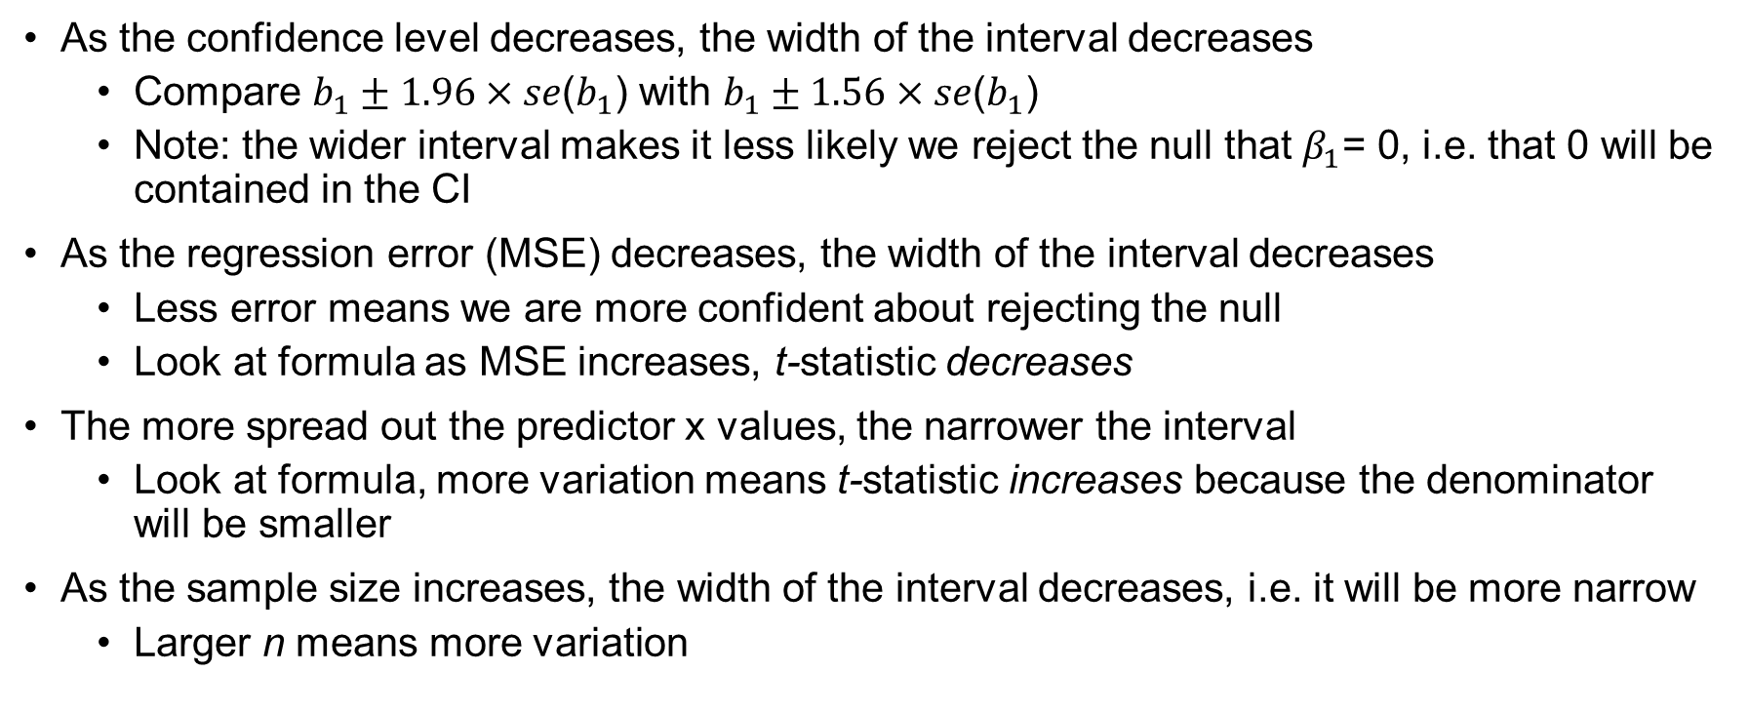
Factors affecting the width of the CI: Making the interval as narrow as possible
As the confidence level decreases, the width of the interval decreases
Compare $b_{1}±1.96×se$($b_{1}$) with $b_{1}±1.56×se$($b_{1}$)
Note: the wider interval makes it less likely we reject the null that $β_{1}$= 0, i.e. that 0 will be contained in the CI
As the regression error (MSE) decreases, the width of the interval decreases
Less error means we are more confident about rejecting the null
Look at formula as MSE increases, t-statistic decreases
The more spread out the predictor x values, the narrower the interval
Look at formula, more variation means t-statistic increases because the denominator will be smaller
As the sample size increases, the width of the interval decreases, i.e. it will be more narrow
Larger n means more variation

Slide 40
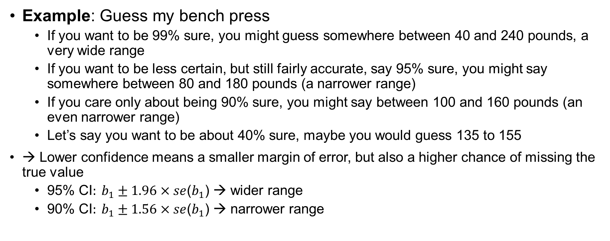
1. As the Confidence Level Decreases, the Width of the Interval Decreases
Example: Guess my bench press
If you want to be 99% sure, you might guess somewhere between 40 and 240 pounds, a very wide range
If you want to be less certain, but still fairly accurate, say 95% sure, you might say somewhere between 80 and 180 pounds (a narrower range)
If you care only about being 90% sure, you might say between 100 and 160 pounds (an even narrower range)
Let’s say you want to be about 40% sure, maybe you would guess 135 to 155
→ Lower confidence means a smaller margin of error, but also a higher chance of missing the true value
$\text{95}\text{\% }\text{CI}: b_{1}±1.96×se$($b_{1}$) → wider range
$\text{90}\text{\% }\text{CI}: b_{1}±1.56×se$($b_{1}$) → narrower range

Slide 41
2. As the Regression Error (MSE) Decreases, the Width of the Interval Decreases
Example: Predicting Commute Time to Work when I lived in Boston and Dublin
Traffic times are widely unpredictable
"I think my commute will take between 20 and 60 minutes.“
The large uncertainty in your estimate means your confidence interval is wide.
High Variability in Traffic (High MSE → Wide Confidence Interval)
Traffic times in Dublin are pretty consistent
"I think my commute will take between 28 and 32 minutes.“
Since there’s less variation in travel time, you can be more confident in your prediction, leading to a narrower confidence interval
Low Variability in Traffic (Low MSE → Narrow Confidence Interval)
Connection
If traffic is unpredictable, you give a wide range of possible commute times (like a wide confidence interval), making it harder to be certain.
If traffic is consistent, you give a narrow range, making it easier to make a firm decision (like rejecting the null)

Slide 42
3. The More Spread Out the Predictor Values, the Narrower the Interval
Example: Imagine you are measuring how study hours predict exam scores.
If everyone in the sample studies between 2-4 hours, it is hard to detect a pattern.
If some study 0 hours and others study 10+ hours, it is easier to see the effect of studying.
→ More spread in predictor values makes the estimate of b₁​ more reliable, leading to a narrower confidence interval.

Slide 43
4. As the Sample Size (𝑛) Increases, the Width of the Interval Decreases
Example: Imagine you are polling people about their favorite class
If you survey only 5 people, their responses may not represent the whole population, and history of ancient civilization may emerge the winner
If you survey 500 people, you get a more reliable estimate that statistics was their favorite class
With larger samples, the margin of error decreases because you are more confident in the results
→ Larger samples provide more precise estimates, making confidence intervals narrower.

Slide 44
Concept, Intuition, and Take-away
Concept | Intuitive Example | Key Takeaway
Lower confidence level → narrower interval | Guessing my bench—higher confidence means a wider range | Higher confidence = wider CI, lower confidence = narrower CI
Less error (MSE) → narrower interval | Commute times—more accuracy means a smaller margin of error | More precise regression estimates lead to narrower confidence intervals
More spread in X → narrower interval | Studying for an exam—more variation in study hours makes it easier to estimate impact | More predictor variation improves estimate precision
Larger sample size → narrower interval | Polling students—bigger samples reduce uncertainty | More data = smaller standard errors and narrower CIs

Slide 45
Another example
Can I predict your graduate GPA based on your undergraduate GPA & score on the GRE
gregpa.sav
Process
Look at descriptive statistics
Calculate the zero order and partial correlations between the variables
Run regression analysis
Interpret coefficients
Evaluate overall model for assumptions and fit

Slide 46
GRE-GPA Example Data
Student | GRE-Total (X₁) | Undergraduate GPA (X₂) | Graduate GPA(Y)
1 | 145 | 3.2 | 4.0
2 | 120 | 3.7 | 3.9
3 | 125 | 3.6 | 3.8
4 | 130 | 2.9 | 3.7
5 | 110 | 3.5 | 3.6
6 | 100 | 3.3 | 3.5
7 | 95 | 3.0 | 3.4
8 | 115 | 2.7 | 3.3
9 | 105 | 3.1 | 3.2
10 | 90 | 2.8 | 3.1
11 | 105 | 2.4 | 3.0

Slide 47
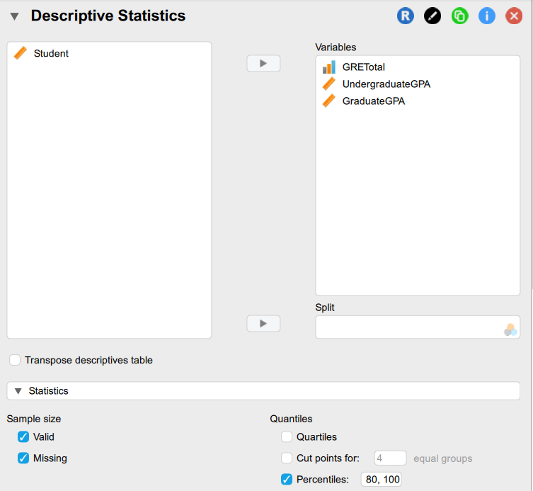
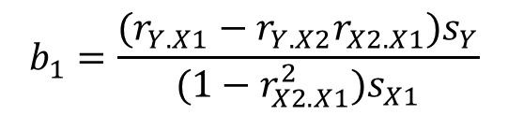
Descriptive Statistics
 | GRE Total | UndergraduateGPA | Graduate GPA
Valid | 11 | 11 | 11
Missing | 0 | 0 | 0
Mean | 112.727 | 3.109 | 3.500
Std. Deviation | 16.335 | 0.401 | 0.332
Minimum | 90.000 | 2.400 | 3.000
Maximum | 145.000 | 3.700 | 4.000
20th percentile | 100.000 | 2.800 | 3.200
40th percentile | 105.000 | 3.000 | 3.400
60th percentile | 115.000 | 3.200 | 3.600
80th percentile | 125.000 | 3.500 | 3.800
100th percentile | 145.000 | 3.700 | 4.000
Y = GPA in graduate school
X1 = GRE score
X2 = Undergraduate GPA
$$b_{1}=\frac{(r_{Y.X1}−r_{Y.X2}r_{X2.X1})s_{Y}}{(1−r_{X2.X1}^{2})s_{X1}}$$

Slide 48

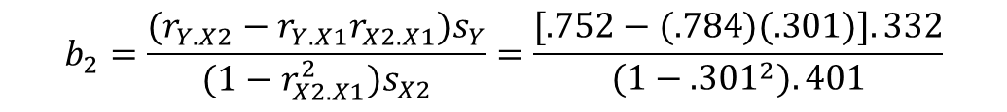
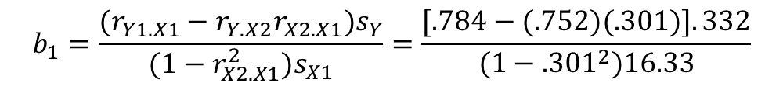


Pearson's Correlations
 |  |  | Pearson's r | p
GRETotal (X1) | - | UndergraduateGPA (X2) | 0.301 | .368
GRETotal (X1) | - | GraduateGPA (Y) | 0.784 | .004
UndergraduateGPA (X2) | - | GraduateGPA (Y) | 0.752 | .008
Zero order (the Pearson
you already know)
$$r_{Y.X1}=.784$$
The correlation between GRE and Graduate GPA
$$r_{Y.X2}=.752$$
The correlation between Graduate GPA and Undergrad GPA
$$r_{X1.X2}=.301$$
The correlation between GRE and Undergraduate GPA
To isolate the unique effect of GRE, we subtract the portion of the GRE-Graduate GPA correlation that is explained by Undergraduate GPA
To isolate the unique effect of Undergraduate GPA we subtract the portion of the Undergraduate GPA–Graduate GPA correlation that is explained by GRE
$$b_{2}=\frac{(r_{Y.X2}−r_{Y.X1}r_{X2.X1})s_{Y}}{(1−r_{X2.X1}^{2})s_{X2}}=\frac{[.752−(.784)(.301)].332}{(1−.301^{2}).401}$$
$$b_{1}=\frac{(r_{Y1.X1}−r_{Y.X2}r_{X2.X1})s_{Y}}{(1−r_{X2.X1}^{2})s_{X1}}=\frac{[.784−(.752)(.301)].332}{(1−.301^{2})16.33}$$
Notes:
The denominator corrects for the shared effort to get the unique contribution – this way, each predictor only gets credit for its unique effect.

Slide 49
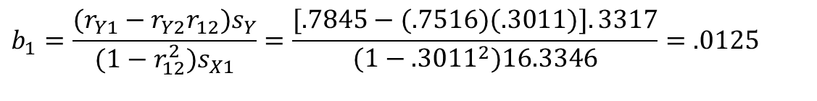
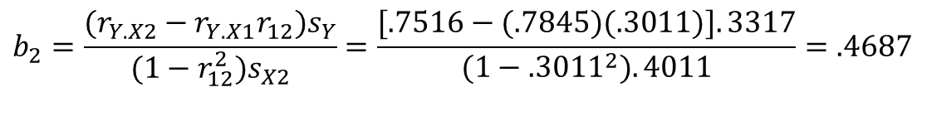
Sample Partial Slope and Intercept
After removing the shared influence of Undergraduate GPA, GRE’s unique predictive power is much lower.
GRE
$$b_{1}=\frac{(r_{Y1}−r_{Y2}r_{12})s_{Y}}{(1−r_{12}^{2})s_{X1}}=\frac{[.7845−(.7516)(.3011)].3317}{(1−.3011^{2})16.3346}=.0125$$
This effect is much stronger than GRE’s effect, indicating that Undergraduate GPA is a better predictor of Graduate GPA than GRE. Removing the influence of GRE did not reduce Undergraduate GPAs’ predictive power as much as it did for GRE.
Undergraduate GPA
$$b_{2}=\frac{(r_{Y.X2}−r_{Y.X1}r_{12})s_{Y}}{(1−r_{12}^{2})s_{X2}}=\frac{[.7516−(.7845)(.3011)].3317}{(1−.3011^{2}).4011}=.4687$$
The Intercept
$$b_{0}=\bar{Y}−b_{1}{\bar{X}}_{1}−b_{2}{\bar{X}}_{2}=$$
$$3.5000−(.0125)(112.7273)−(.4687)(3.1091)=.6337$$

Slide 50

Sample Multiple Linear Regression Model
$\hat{Y\text{i}}$= .6337 + .0125 X₁ + .4687 X₂
If your score on the GRETOT was 130 and your UGPA was 3.5, then your predicted score on the GGPA would be computed as:
$\hat{Y\text{i}}$ = .0125 (130) + .4687 (3.5000) + .6337 = 3.8992
Admissions Data Analysis Example in R

Slide 51
Model Evaluation
The four conditions tell us what can go wrong
The population regression function is nonlinear
The error term is not independent
The error terms are not normally distributed
The error terms do not have equal variance
Other major issues
Presence of outliers
Bias due to an omitted variable (i.e., omitted variable bias)
Reinforce the importance of these assumptions
In OLS the tests we perform are extremely sensitive to model assumptions
Notes:
The response is not a function of linear trend plus error

Slide 52
Checking the Assumptions
We must check to see whether these assumptions are reasonable or not.
If the assumptions hold, then our assumed model is correct:
Linearity → Use (standardized) Residuals vs. (Standardized) Fitted plot
Independence → Use Durbin-Watson test
Normality → Use Normal Q-Q plot
Equal Variance → Use Residuals vs. Fitted plot (aka as above)

Slide 53
Residual v Predicted (Fitted) Plot
The bivariate plot of the predicted values against model residuals can help us infer whether the relationships of the predictors to the outcome are linear and whether there is homogeneity of variance.
The plot consists of residuals on the y-axis and fitted values on the x-axis
Here is what you are looking for:
The residuals "bounce randomly" around the residual = 0 line. This suggests that the assumption of a linear relationship is reasonable.
The residuals roughly form a "horizontal band" around the residual = 0 line. This suggests that the variances of the error terms are equal.
No one residual "stands out" from the basic random pattern of residuals. This suggests that there are no outliers.

Slide 54
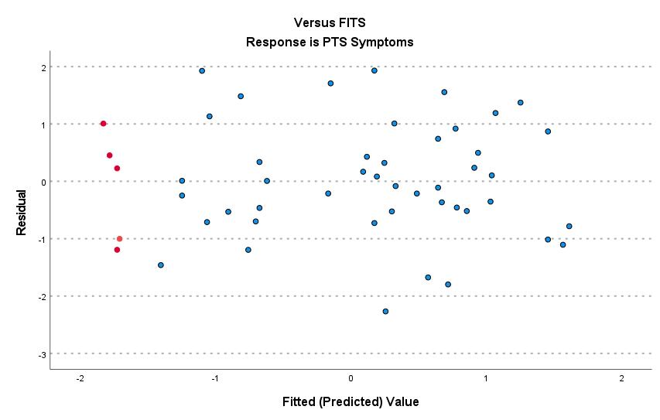
Linearity (good)
The plot suggests that there is a decreasing linear relationship between alcohol and PTSS. It also suggests that there are no anomalous data points in the dataset. And, it illustrates that the variation around the estimated regression line is constant suggesting that the assumption of equal error variances is reasonable.
Underpredicted
Overpredicted
In this example, we think alcohol use predicts PTSS.
Notes:
So lets say that my predicted PTS score is 55 and the model predicts 60
55 – 60 - -5
The model OVERPREDICTED
If the model predicts 45 then the model underpredicted and the residual will be positive (i.e., 5 → 55-45 = 10 > 0).
More importantly lets think through what the residual means, i.e.,
1. What does the residual mean here?
why would the variance be constant or non-constant? Remember the model variance is the variance of the ERROR term. Let’s do the NONconstant variance first.

Slide 55
Substantive meaning of residual
The residual means: after accounting for alcohol use (and whatever else is in the model), how far above or below the “expected” PTS score a person is.
In this framing, the residual is the part of the PTSS symptoms not explained by alcohol use—measurement noise, omitted factors, plus genuine individual variability.
→ what other factors explain PTSS besides alcohol use that would explain variation in PTSS symptoms across individual?
Note: We could also have predicted alcohol use from PTSS

Slide 56
Constant variance (homoskedasticity) in this context
Constant variance: for any level of alcohol use (low, medium, high), the spread of those unexplained parts is about the same.
Substantively, that’s saying alcohol use shifts the mean PTS level (the regression line), but it doesn’t change how “predictable” PTS is across the alcohol spectrum.
People with low alcohol use vary around their predicted PTS by about the same amount as people with high alcohol use.
In a residual plot (residuals vs. fitted values or vs. alcohol), you’d see roughly the same vertical scatter everywhere—no widening, no narrowing, no pattern.

Slide 57
Non-constant variance (heteroskedasticity): what it would mean with alcohol → PTSS
Non-constant variance: the model’s errors get bigger or smaller depending on alcohol use (or depending on predicted PTS). So the predictability of PTS changes across the alcohol range.
Fan shape: residual spread increases at higher alcohol use. Interpretation: among people with heavier alcohol use, PTS symptoms are much more heterogeneous for reasons your model doesn’t capture. Some people with high alcohol use might have extremely high PTS (e.g., severe trauma exposure, comorbid depression, ongoing victimization), while others might have more moderate PTS (e.g., different trauma types, stronger support, different coping patterns). Alcohol is related to the mean, but high-use cases are “messier,” so the unexplained variance inflates.
Reverse fan: residual spread decreases at higher alcohol use. at high alcohol use levels, PTS is more uniformly high (a kind of ceiling/constraint), or the relationship is more deterministic for that subgroup.
Another version is a measurement issue: maybe severe alcohol use is measured more reliably than low-level use, or the PTS measure behaves differently at different ranges.

Slide 58
Non-constant variance (heteroskedasticity): what it would mean with alcohol → PTSS
Non-constant variance: the model’s errors get bigger or smaller depending on alcohol use (or depending on predicted PTS). So the predictability of PTS changes across the alcohol range.
Curved pattern + changing spread. Sometimes what looks like heteroskedasticity is partly “wrong functional form.” If the true relationship is nonlinear (e.g., PTS barely changes from 0–3 drinks, then rises sharply, then plateaus), fitting a straight line can leave systematic structure in residuals and also create apparent variance changes.
Variance differs by subgroup that correlates with alcohol. If gender, trauma type, time since trauma, or treatment status changes both alcohol use and the variability of PTS, then the residual variance can differ across the alcohol range because you’re mixing different variance-regimes. Example: high alcohol use might be more common among people with multiple traumas; that subgroup might have wider PTS variability, so the residuals widen at high alcohol.

Slide 59
Homogeneity of Variance
$$y=β_{0}+β_{1}x+ε$$
Homoscedasticity (defined): The variance of the residuals is homogeneous across levels of the predicted values
Equal variance of the distribution of the response variable for each level of the independent variable (homoscedasticity, the violation is called heteroskedasticity)
The spread of the response around the straight line is same for all levels of explanatory variable
Errors have constant variance
equal variance
non-linear (curvilinear)
increasing variance
time trend
Notes:
Three primary types of violations common in our research

Slide 60
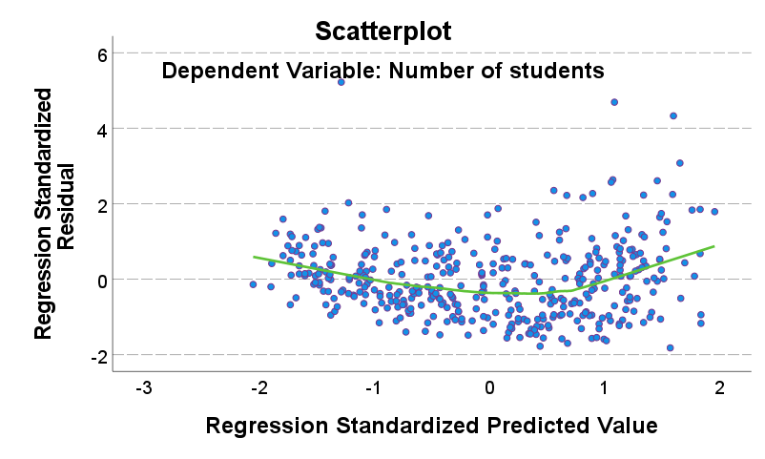
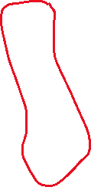

Homogeneity of Variance
If the model is well-fitted, there should be no pattern to the residuals plotted against the fitted values
If we look carefully at the plot, we see that the lower values of the standardized predicted values tend to have lower variance around zero.

Slide 61
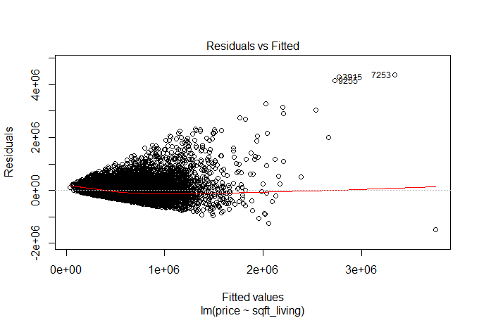
Fitted Values vs. Residuals Plot
Looking for equal variance & linearity
Not looking for
Curvilinear
Non-constant variance
Outliers
Time trends

Slide 62
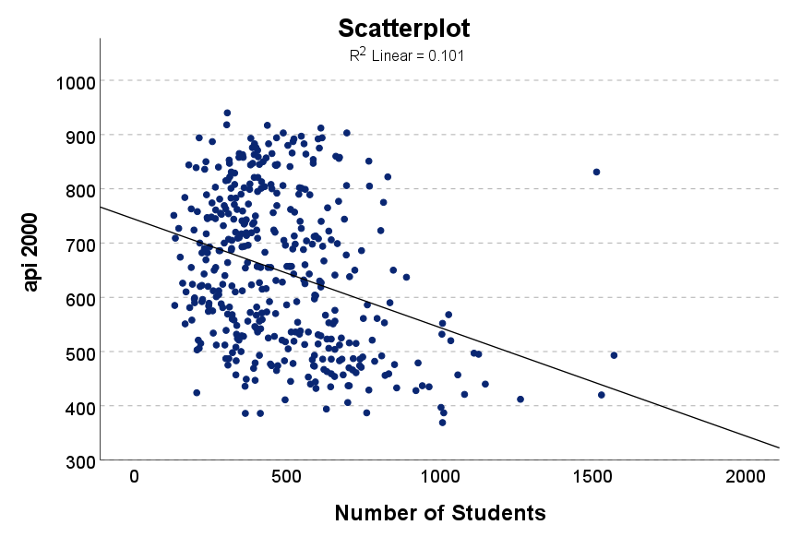
Linearity (bad) API2000 (academic performance) v Enroll (number of students)

Slide 63
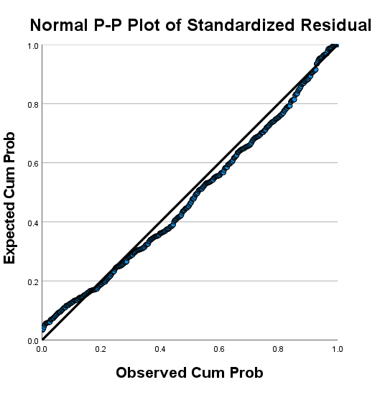
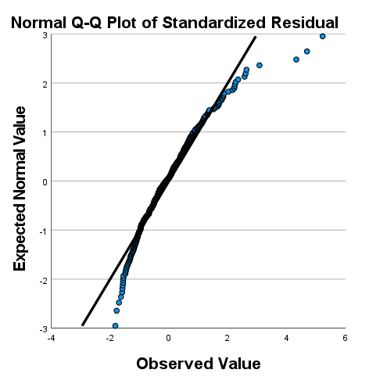
Normality of Residuals
In linear regression, a common misconception is that the outcome has to be normally distributed, but the assumption is actually that the residuals are normally distributed
A normal probability plot (P-P plot) helps us assess normality of the errors
A normal Q-Q performs the same function but SPSS does not have the option so we will create it using JASP

Slide 64
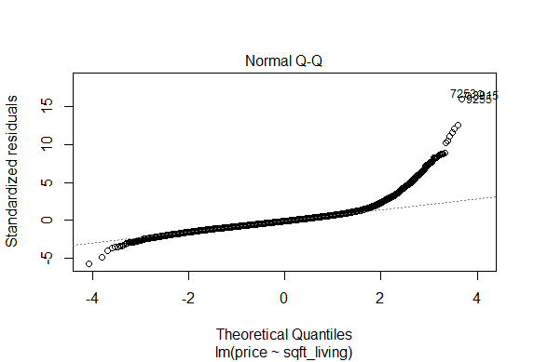
Normal Probability Plot
Looking for points to fall along the dashed line (normal distribution)

Slide 65
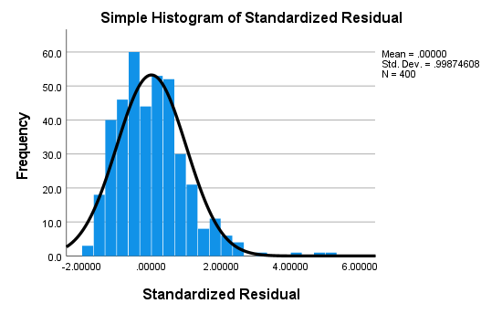
Histogram of Standardized Residuals
You can also get a sense of normality of errors by saving the standardized residuals and then creating a histogram plot with a normal overlay
This is the same result as the normal probability plot, showing a slightly right skew to the data

Slide 66
Checking for independence of residuals
Use Durbin Watson test statistic (simple)
The question is whether the residuals from the regression model are autocorrelated
Autocorrelation is the degree to which the error term of one observation is related to the error term of a different observation
The null hypothesis: the residuals are independent
Large p-value indicates the residuals are not correlated (GOOD)
Small p-value indicates the residuals are correlated (BAD)
Notes:
This is VERY common when testing model diagnostics oftentimes you DO NOT want to reject the null

Slide 67
Checking for independence
The DW statistic ranges from zero to four, with a value of 2.0 indicating zero autocorrelation
Values below 2.0 mean there is positive autocorrelation and above 2.0 indicates negative autocorrelation
Ideally, the DW should be between 1 and 3
SPSS gives the statistic only, JASP gives the value, the statistic and the p-value

Slide 68
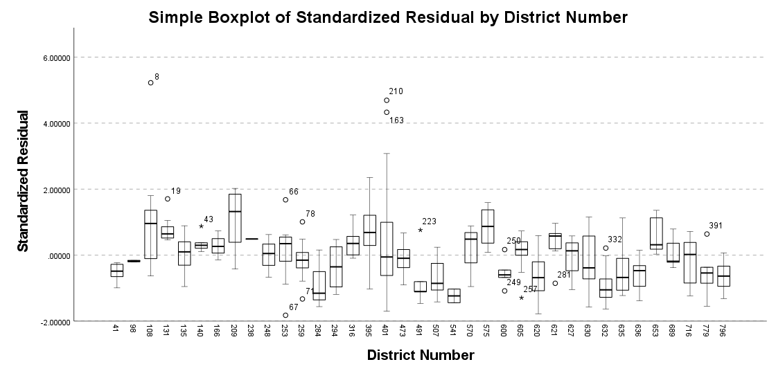
Independence of Observations
When residuals are independent, they are randomly distributed across all units. Below, if residuals were truly
independent, they would be randomly distributed across all districts. Instead, we see that some districts have
consistently positive or negative residuals. This suggests that student performance within the same district is
systematically overpredicting or underpredicting outcomes in certain districts, violating independence.
Standard residuals of student performance on
standardized tests across school districts
Example: Gapminder
Notes:
Errors should not be related to any grouping factor
If residuals are independent, they should look random across districts — meaning some districts would have slightly positive residuals, others slightly negative, but there would be no consistent pattern.
In this plot, however, some districts have residuals that are consistently above zero, while others are consistently below zero.
This means the model is systematically overpredicting or underpredicting outcomes in certain districts, rather than errors being random.
So students within the same district are performing more similarly to each other than to students in other districts. That means observations within districts are not independent, and the independence assumption is violated.

Slide 69
Issues of Independence
Independence is driven to a large degree by the method of data collection
Therefore, violations can occur in a variety of situations
Consider data on child welfare allegations in a particular state
Why might these data violate the independence assumption
If you have clustered data, you need to incorporate the clustering into your model
You can get a general sense about violations of independence via descriptive statistics
Barboza-Salerno, G. E., Steinke, H., Meshelemiah, J. C., Stanek, C., Duhany, S., & Cash, S. (2025). A multilevel analysis of individual and community factors associated with case dispositions following child maltreatment investigations. Child maltreatment, 30(1), 108-122.

Slide 70
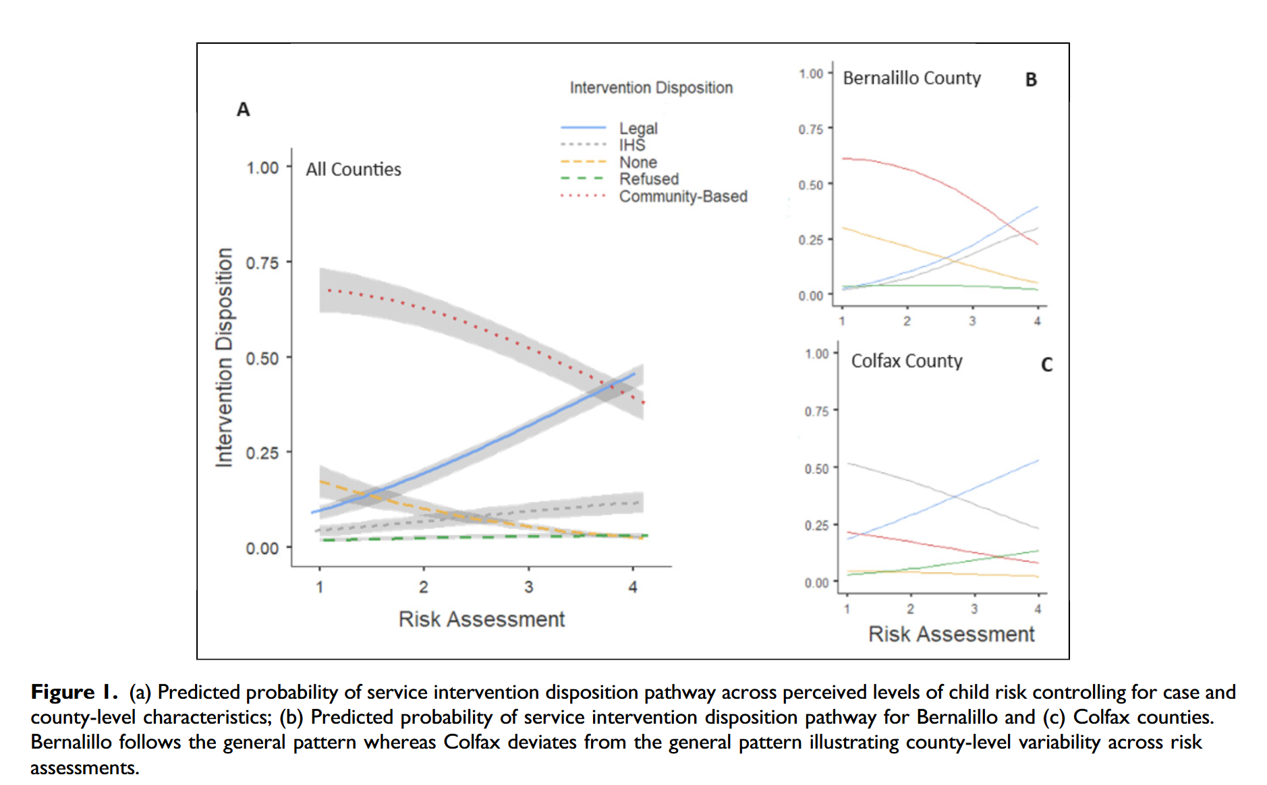
Example
Barboza-Salerno, G. E., Steinke, H., Meshelemiah, J. C., Stanek, C., Duhany, S., & Cash, S. (2025). A multilevel analysis of individual and community factors associated with case dispositions following child maltreatment investigations. Child maltreatment, 30(1), 108-122.

Slide 71
Note that all fit statistics are model-dependent; their results may change if we add more predictors. Note to not forget about omitted variables (model specification) which is not unique to MLR

Slide 72
Multicollinearity
Multicollinearity is when the predictors in the regression equation are correlated with each other
One of the assumptions of the linear regression model is that there is no exact linear relationship among the regressors
Perfect collinearity: A perfect linear relationship between the two variables exists.
Imperfect collinearity: The regressors are highly (but not perfectly) collinear
Why care?
Multicollinearity can make it difficult to determine the unique effect of each predictor because correlated predictors share overlapping information about the outcome
As a result, individual regression coefficients may appear statistically insignificant—even when together they explain a lot of variation in the outcome
This can lead us to mistakenly conclude that important predictors have no real effect, when in reality their effects are obscured by overlap with other variables
An easy way to allay people’s fears is by checking the VIF statistics (NOT CORRELATION AMONG VARIABLES)

Slide 73
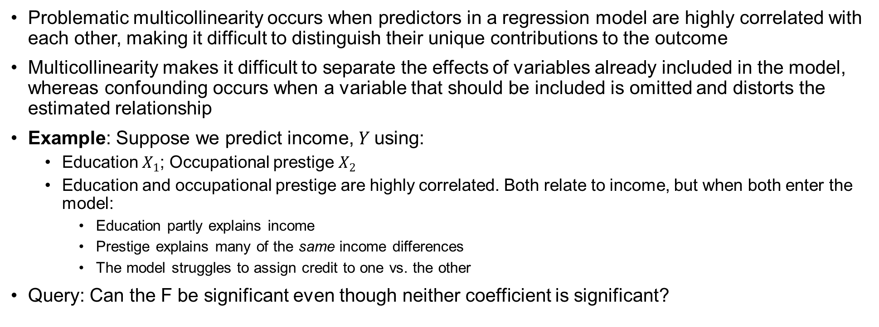
Relationship between Multicollinearity and Confounding
Problematic multicollinearity occurs when predictors in a regression model are highly correlated with each other, making it difficult to distinguish their unique contributions to the outcome
Multicollinearity makes it difficult to separate the effects of variables already included in the model, whereas confounding occurs when a variable that should be included is omitted and distorts the estimated relationship
Example: Suppose we predict income, $Y$using:
Education $X_{1}$; Occupational prestige $X_{2}$
Education and occupational prestige are highly correlated. Both relate to income, but when both enter the model:
Education partly explains income
Prestige explains many of the same income differences
The model struggles to assign credit to one vs. the other
Query: Can the F be significant even though neither coefficient is significant?
Annotated JASP file for PRAMS data

Slide 74
Multicollinearity
As the number of predictors increases, multiple regression modeling can become very complicated
Example: Suppose you use both educational attainment and job type as independent variables to predict income
Educational attainment and job type are highly correlated! Thus having both educational attainment and job type in your multiple regression equation may only slightly improve the R² over an equation with just educational attainment (think semipartial correlation ☺)
Might conclude that job type is highly influential on income, while educational attainment is unimportant (or vice versa) which is not true!
Note that while the may be substantial overlap between variables theoretically, they could be measuring very different concepts
This happened in our paper for SSRW when we included an index of redlining, concentrated disadvantage, and concentrated affluence in the model
The opposite of concentrated disadvantage is not concentrated advantage
Use theory to guide the model building!!!!!

Slide 75
Multicollinearity
Partial correlation removes education from both job type and income, then correlates the leftovers.
Semipartial correlation removes education only from job type, then relates what remains of job type to income.
In regression terms:
Partial correlation = relationship after controlling for education on both sides.
Semipartial correlation = unique increase in R2 when adding job type to a model already containing education.

Slide 76
Multicollinearity and Partial Correlation
Multicollinearity in our previous example:
High correlation between ADI, racial segregation, and lending trajectory can inflate standard errors, making it harder to detect true effects.
Can result in unstable coefficient estimates in regression models.
Variance Inflation Factor (VIF) (below) can assess the severity of multicollinearity.

Slide 77
Multicollinearity and Partial Correlation
Example: Examine the relationship between lending trajectory and firearm-related homicide, controlling for ADI and segregation.
There are three possible outcomes:
Case 1: Association disappears or becomes very small or is eliminated. This suggests that the original relationship was primarily due to deprivation and segregation, meaning those variables may be the mechanism by which lending is associated with firearm-related violence (i.e., mediators).
Case 2: Association weakens but still exists. This suggests part of the original relationship was due to deprivation and segregation (confounding), but lending still has an independent association with violence.
Case 3: Association barely changes. This suggests deprivation and segregation were not driving the relationship much at all.

Slide 78
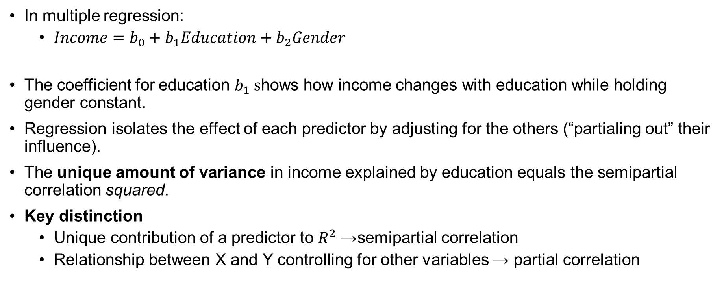
Is regression based on partial or semi-partial correlation?
In multiple regression:
$Income=b_{0}+b_{1}Education+b_{2}Gender$
The coefficient for education $b_{1} s$hows how income changes with education while holding gender constant.
Regression isolates the effect of each predictor by adjusting for the others (“partialing out” their influence).
The unique amount of variance in income explained by education equals the semipartial correlation squared.
Key distinction
Unique contribution of a predictor to $R^{2}$→ semipartial correlation
Relationship between X and Y controlling for other variables → partial correlation

Slide 79
What to do if you find multicollinearity?
If two variables are highly correlated, it is probably not a good idea to use both in the regression equation. Why?
Many correlated variables hurts the Adjusted R²
We generally prefer smaller models
Smaller models are much easier to interpret
Multiple regression models describe the effect of one variable on another after partialling out the effects of all other variables in the model
Regarding MC, this means that if two variables are highly correlated, once one of them is partialled out, there is much less variation left in the other variable for the model to “explain”
Check the partial correlation coefficients and zero order coefficients before including variables! But, beware.

Slide 80
Clues that MC is a problem
High R² but few significant t ratios
High pair-wise correlations among explanatory variables or regressors
High partial correlation coefficients
High Variance Inflation Factor (VIF) and low Tolerance Factor (TOL, the inverse of VIF)

Slide 81
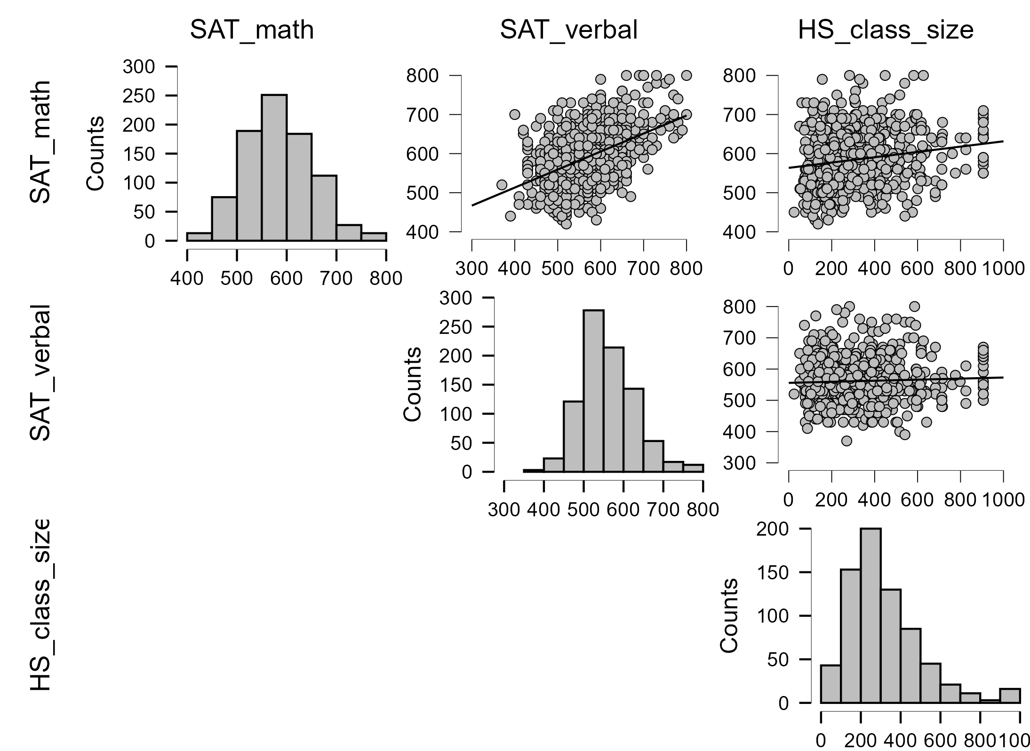
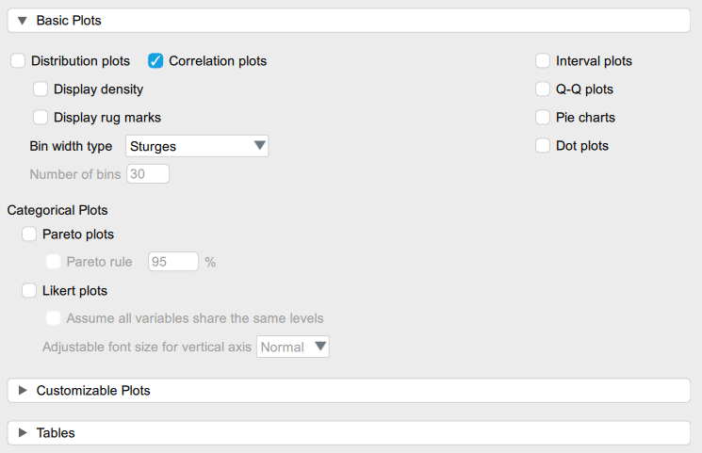
How to check for multicollinearity?
Descriptives tab in JASP

Slide 82
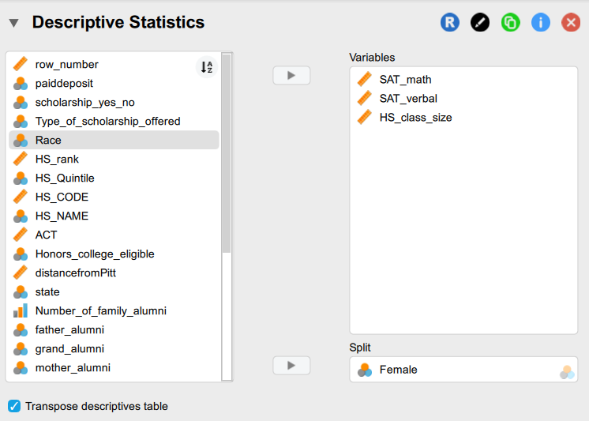
How to check for multicollinearity?

Slide 83
Variance Inflation Factor
$$Y_{i}=β_{0}+β_{1}X_{1i}+β_{2}X_{2i}+u_{i}$$
$$VIF=\frac{1}{1−r_{12}^{2}}$$
VIF is a measure of the degree to which the variance of the OLS estimator is inflated because of collinearity.

Slide 84
What should we do if we detect multicollinearity?
Nothing, for we often have no control over the data and our model is driven by theory
Redefine the model by excluding variables may attenuate the problem, provided we do not omit relevant variables
Principal components analysis (this is something we will cover later)

Slide 85
Outliers
Outlier: An outlier is unusual in the outcome (Y).
The response value does not follow the general pattern seen in the rest of the data.
Example: if income usually increases with education, but one person with very high education has an extremely low income, that observation may be an outlier in Y.
Outliers are often identified using the interquartile range (IQR) rule:
A point is considered an outlier if it falls beyond 1.5 times the IQR (i.e., 1.5×(𝑄3−𝑄1)) above the third quartile (Q3) or below the first quartile (Q1).
Notes:
or may be "unusual" combinations of predictor values

Slide 86
Leverage Points
High Leverage Point: A data point with an extreme value for one or more predictor variables (X).
It occurs when a data point has predictor values that are far from where most observations lie.
Such points matter because regression lines or planes are pulled toward extreme values of the predictor.
In a single predictor model, this is easy to see. A high leverage point simply has a very large or very small X value compared to the rest of the data.
In a multiple predictor model, things become less obvious because leverage depends on the combination of predictors, not just one variable at a time. A point may not look extreme on any single predictor, but the combination of values may be unusual.
Notes:
or may be "unusual" combinations of predictor values

Slide 87
Leverage Example
Example: Suppose education and job experience are strongly positively correlated — people with more education usually also have more experience. Most observations lie along that pattern.
Imagine someone with extremely high education but very low experience. Neither value alone may look extreme, but that combination is rare.
Because the regression surface has little data in that region, this case can strongly influence the fitted model, giving it high leverage.
So the key idea is:
Outlier → unusual Y value.
High leverage → unusual X combination.

Slide 88
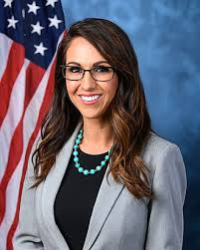



Who’s the problem? Influencers, Leverag-ors and Outliers
Trendsetters: Some people are influential; they set trends (high leverage, strong influence). Extreme values that change the regression line.
High leverage, no influence: An extreme value i.e., lots of followers but no real impact
Bizarre: Some things are outliers, meaning they are an unusual outcome (i.e., millions made on a pet rock), but sales follows the general ‘trend’

Slide 89
When is leverage + outlier a problem?
In regression, a point is influential only if it combines high leverage (unusual X values) and a large residual (it does not follow the trend of the regression line)
Low leverage + outlier in Y → weird point, little effect.
High leverage + small residual → reinforces trend, little effect.
High leverage + large residual → influential point.

Slide 90
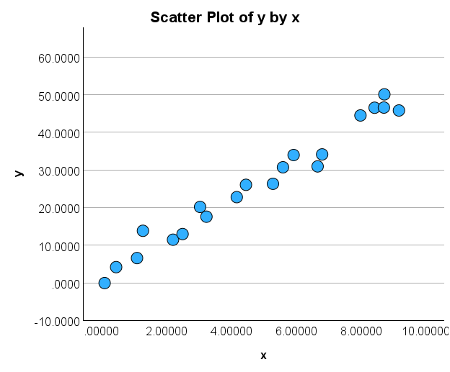
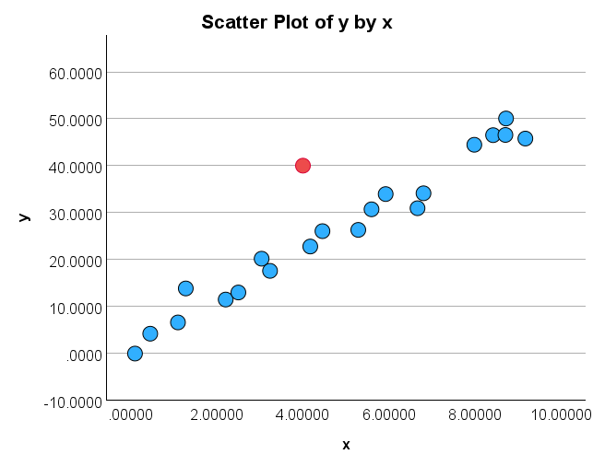
Outliers and Leverage Points
Influence1.sav
A
Does anything look unusual or different about plot A?
B
Does anything look unusual or different about plot B?
Influence1.sav
Notes:
The red point in B is not an extreme x value, so it does not have high leverage.
Is the red data point influential? An easy way to determine if the data point is influential is to find the best fitting line twice — once with the red data point included and once with the red data point excluded. Then note any glaring differences or inconsistencies

Slide 91
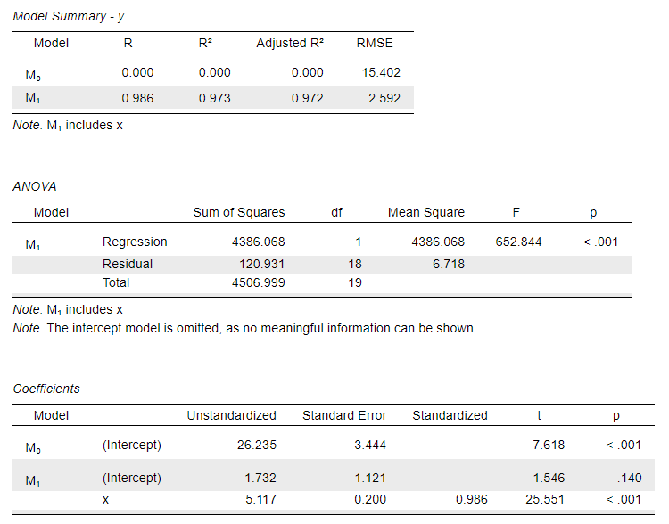
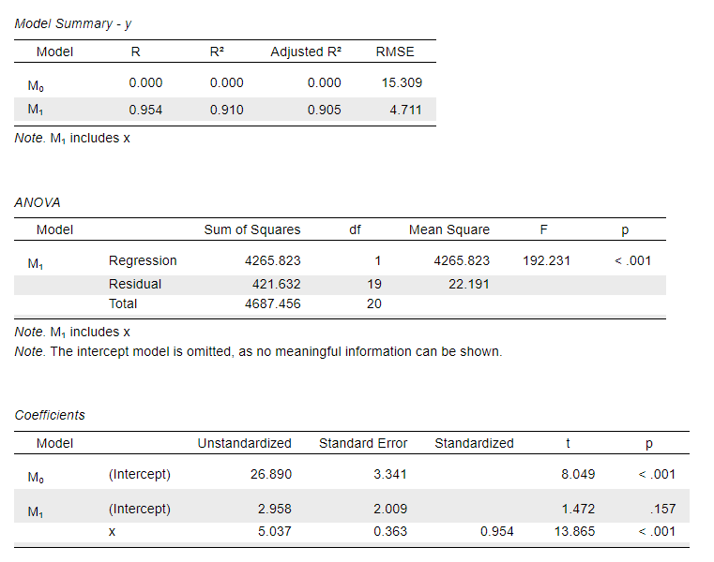
Regression output
Compare the two regressions, any differences?
A
B
Notes:
The R² value has decreased slightly, but the relationship between y and x would still be deemed strong.
The standard error of b₁, which is used in calculating our confidence interval for β₁, is larger when the red data point is included, thereby increasing the width of our confidence interval. You may recall that the standard error of b₁ depends on the mean squared error MSE, which quantifies the difference between the observed and predicted responses. It is because the red data point is an outlier — in the y direction — that the standard error of b₁ increases, not because the data point is influential in any way.
In each case, the P-value for testing H₀: β₁ = 0 is less than 0.001. In either case, we can conclude that there is sufficient evidence at the 0.05 level to conclude that, in the population, x is related to y.

Slide 92
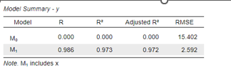



Compare & Intuit
Lines are fairly similar BUT More error & less confidence → smaller t-value, bigger standard errors, wider confidence interval

Slide 93


Influence3.sav
From above
Notes:
The R² value has hardly changed at all, increasing only slightly from 97.3% to 97.7%. In either case, the relationship between y and x is deemed strong.
The standard error of b₁ is about the same in each case — 0.172 when the red data point is included, and 0.200 when the red data point is excluded. Therefore, the width of the confidence intervals for β₁ would largely remain unaffected by the existence of the red data point. You might take note that this is because the data point is not an outlier heavily impacting MSE.
In each case, the P-value for testing H₀: β₁ = 0 is less than 0.001. In either case, we can conclude that there is sufficient evidence at the 0.05 level to conclude that, in the population, x is related to y.

Slide 94

Unusual values and influential points
Does anything look unusual or different about this plot?

Slide 95

Unusual values and influential points
B

Slide 96

Leverage and Influence in Regression Analysis
Leverage Depends Only on Predictor Values:
Leverage measures how far an observation’s predictor values (X values) are from the mean of all predictor values.
It is purely a function of X and does not depend on the response variable (Y)
Leverage Indicates Potential Influence, Not Actual Influence
A data point with high leverage has the potential to impact the regression model significantly
However, whether it is truly influential depends on how different its actual Y value is from the predicted trend
Determining High and Worrisome Leverage:
The leverage of an observation is denoted as ​ $h_{ii}$
The mean leverage value in a model with p predictors and n observations is $\overline{h}=\frac{p+1}{n}$
Leverage is too large if $h_{ii}>3×\overline{h}$

Slide 97


Leverage
$$\overline{h}=\sum_{i=1}^{n}{\frac{h_{ii}}{n}}=\frac{p}{n}$$
p = # of parameters in the model and n = the number of observations
That is, if:
Then flag the observations as unusual → X is an observation whose value gives it large leverage for the regression analysis
$$h_{ii}>3\left(\frac{p}{n}\right)$$

Slide 98


Example
You perform a SLR with n = 21 cases. What is the leverage cutoff value that gives you some reason to be concerned?
p = 2, n = 21
$h_{ii}>3\left(\frac{2}{21}\right)$=.286

Slide 99
Can have JASP provide diagnostics
Coefficients
Model |  | Unstandardized | Standard Error | Standardized | t | p
M₀ | (Intercept) | 25.700 | 3.319 |  | 7.743 | < .001
M₁ | (Intercept) | 8.505 | 4.222 |  | 2.014 | .058
 | x | 3.320 | 0.686 | 0.743 | 4.838 | < .001
Influential Cases
Case Number | Std. Residual | y | Predicted Value | Residual | Cook's Distance | Leverage
21 | -4.230 | 15.000 | 51.662 | -36.662 | 4.048* | 0.312*
* Potentially influential case, according to the selected influence measure.

Slide 100
Residuals Statistics
 | Minimum | Maximum | Mean | SD | N
Predicted Value | 8.837 | 51.662 | 25.700 | 11.300 | 21
Residual | -36.662 | 12.617 | -2.435e-16 | 10.181 | 21
Std. Predicted Value | -1.492 | 2.297 | -5.772e-18 | 1.000 | 21
Std. Residual | -4.230 | 1.274 | -0.030 | 1.125 | 21
Influential Cases
Case Number | Std. Residual | y | Predicted Value | Residual | Cook's Distance | Leverage | Mahalanobis
21 | -4.230 | 15.000 | 51.662 | -36.662 | 4.048* | 0.312* | 5.278
* Potentially influential case, according to the selected influence measure.

Slide 101
Statistic | Meaning | Cutoffs | Example from above
Residual | The difference between observed and predicted values (Y - Y-hat). | Values far from 0 indicate poor model fit; extreme values suggest outliers. | Min: -36.6619 (Potential extreme residual)
Standardized Residual | Residual divided by its standard deviation, helping detect outliers. | Greater than ±2 suggests a possible outlier; greater than ±3 is a likely outlier. | Min: -3.510 (Likely outlier)
Studentized Residual | Similar to standardized residual but adjusted for variance, used for identifying influential cases. | Greater than ±2 suggests a possible outlier; greater than ±3 is a likely outlier. | Min: -4.230 (Highly influential outlier)
Deleted Residual | Residual recalculated after removing the observation, helping assess influence. | No strict cutoff, but large deviations suggest influence on the model. | Min: -53.2515 (Extreme case)
Studentized Deleted Residual | Deleted residual standardized to assess the impact of omitting an observation. | Greater than ±3 suggests a highly influential data point. | Min: -17.047 (Highly influential)
Mahalanobis Distance | Measures how far an observation is from the mean in predictor space. | Values greater than 15 in small samples may indicate an outlier. | Max: 5.278 (Moderate distance from center)
Cook’s Distance | Measures the influence of a single case on the regression model. | Values greater than 1 indicate highly influential points. | Max: 4.048 (high influence)
Centered Leverage Value | Indicates the extent to which an observation’s predictor values are extreme. | Concern if > 3(p/n) (where p = predictors, n = obs.) | Max: 0.264 (max = .264 exceeds)

Slide 102
Go over the assignment 1

Slide 103
Effect Size, Confidence Intervals, and Diagnostic Criteria
Week 6
January 10, 2025

Slide 104
Effect Size: What it is, why it matters
Measure of the magnitude of a relationship or difference
Why it matters
Provides practical significance rather than just statistical significance
Helps compare results across studies (meta-analysis)(but see condom study)
Types
For mean differences (e.g., Cohen’s d)
For correlations (e.g., Pearson’s r, part and partial correlation)
For categorical data (e.g., Odds Ratio, Risk Ratio)
Interpreting guidelines
Importance of context in interpretation

Slide 105

Cohen’s d was used here to answer a simple question:
How big is the difference between high-deprivation and low-deprivation counties?
Not just whether they differ, but how large the difference is in practical terms.
What was done
I divided counties into two groups:
Lowest 25% ADI counties (least deprived)
Highest 25% ADI counties (most deprived)
Then you compared the average ADI values in those two groups.
But instead of just reporting the raw difference in ADI scores, Cohen’s d expresses that difference in standard deviation units, using:
$d=\frac{{\text{Mean}}_{high}−{\text{Mean}}_{low}}{\text{pooled} \text{SD}}$
So Cohen’s d tells us how far apart are the two groups relative to the overall variability in ADI?
Analysis of Area Deprivation Disparities Using Cohen’s D – Statistics for Social Work

Slide 106
Why not just compare means?
Suppose the difference in means is 20 ADI points. Is that large or small?
We can’t tell unless we know how much ADI normally varies.
• If ADI usually varies by only 5 points, then 20 is huge. • If ADI varies by 100 points, then 20 is small.
Cohen’s d standardizes the difference so we can interpret magnitude.
What Cohen’s d tells us
A result of d = 3.39 means:
The average high-deprivation county is more than three standard deviations worse than low-deprivation counties.
That is an extremely large separation between groups.
Why use Cohen’s d here?
Because with thousands of counties, a statistical test would always be significant. Cohen’s d instead tells us:
Not just that groups differ, but how large the disparity actually is.

